Slide 1
2026-1-HU01-KA121-SCH-000428455
Green Minds & Puglia's Wonders
ERASMUS+ ACCREDITATION PROGRAM
Csongrádi Batsányi János Gimnázium’s Student Mobility in Torremaggiore, Italy
LOCATION
DATE
PARTICIPANTS
ISISS "Fiani - Leccisotti", Puglia
October 5–9, 2026
10 Students , 1 teacher

Slide 2
2026-1-HU01-KA121-SCH-000428455
Mobility at a Glance
10
5
3
Hungarian Students
Action-Packed Days
Core Pillars

Slide 3


STRATEGIC OBJECTIVES
2026-1-HU01-KA121-SCH-000428455
Key Program Pillars
Social Inclusion
Sustainability
ICT & Collaboration
Integrated workshops with fewer opportunities peers.
Upcycling urban wear & ecological discovery.
Canva digital design & cooperative teamwork.

Slide 4
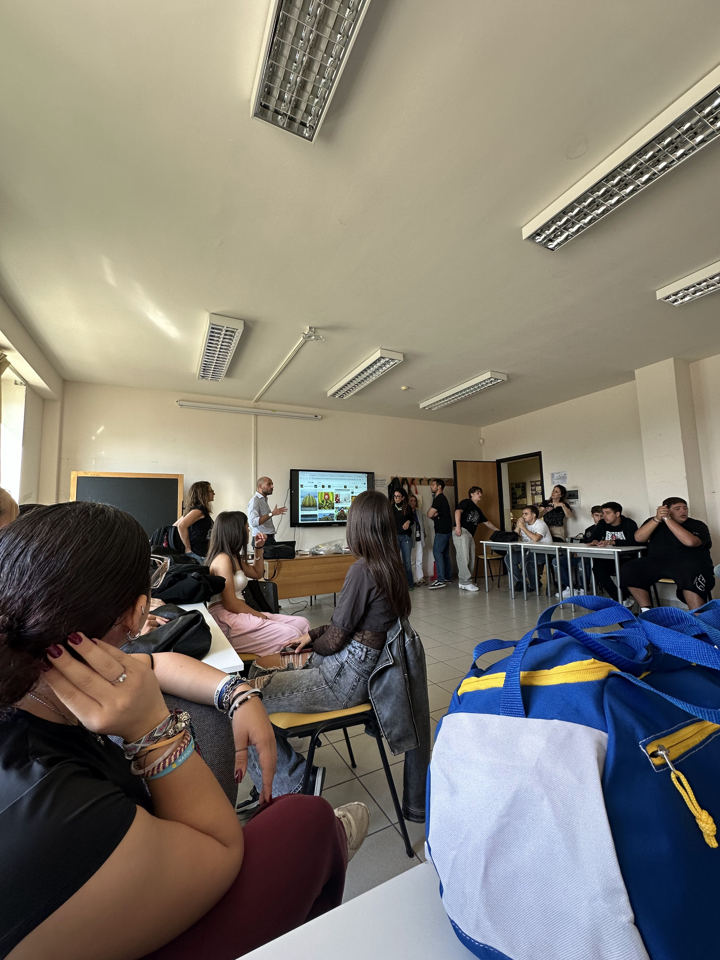
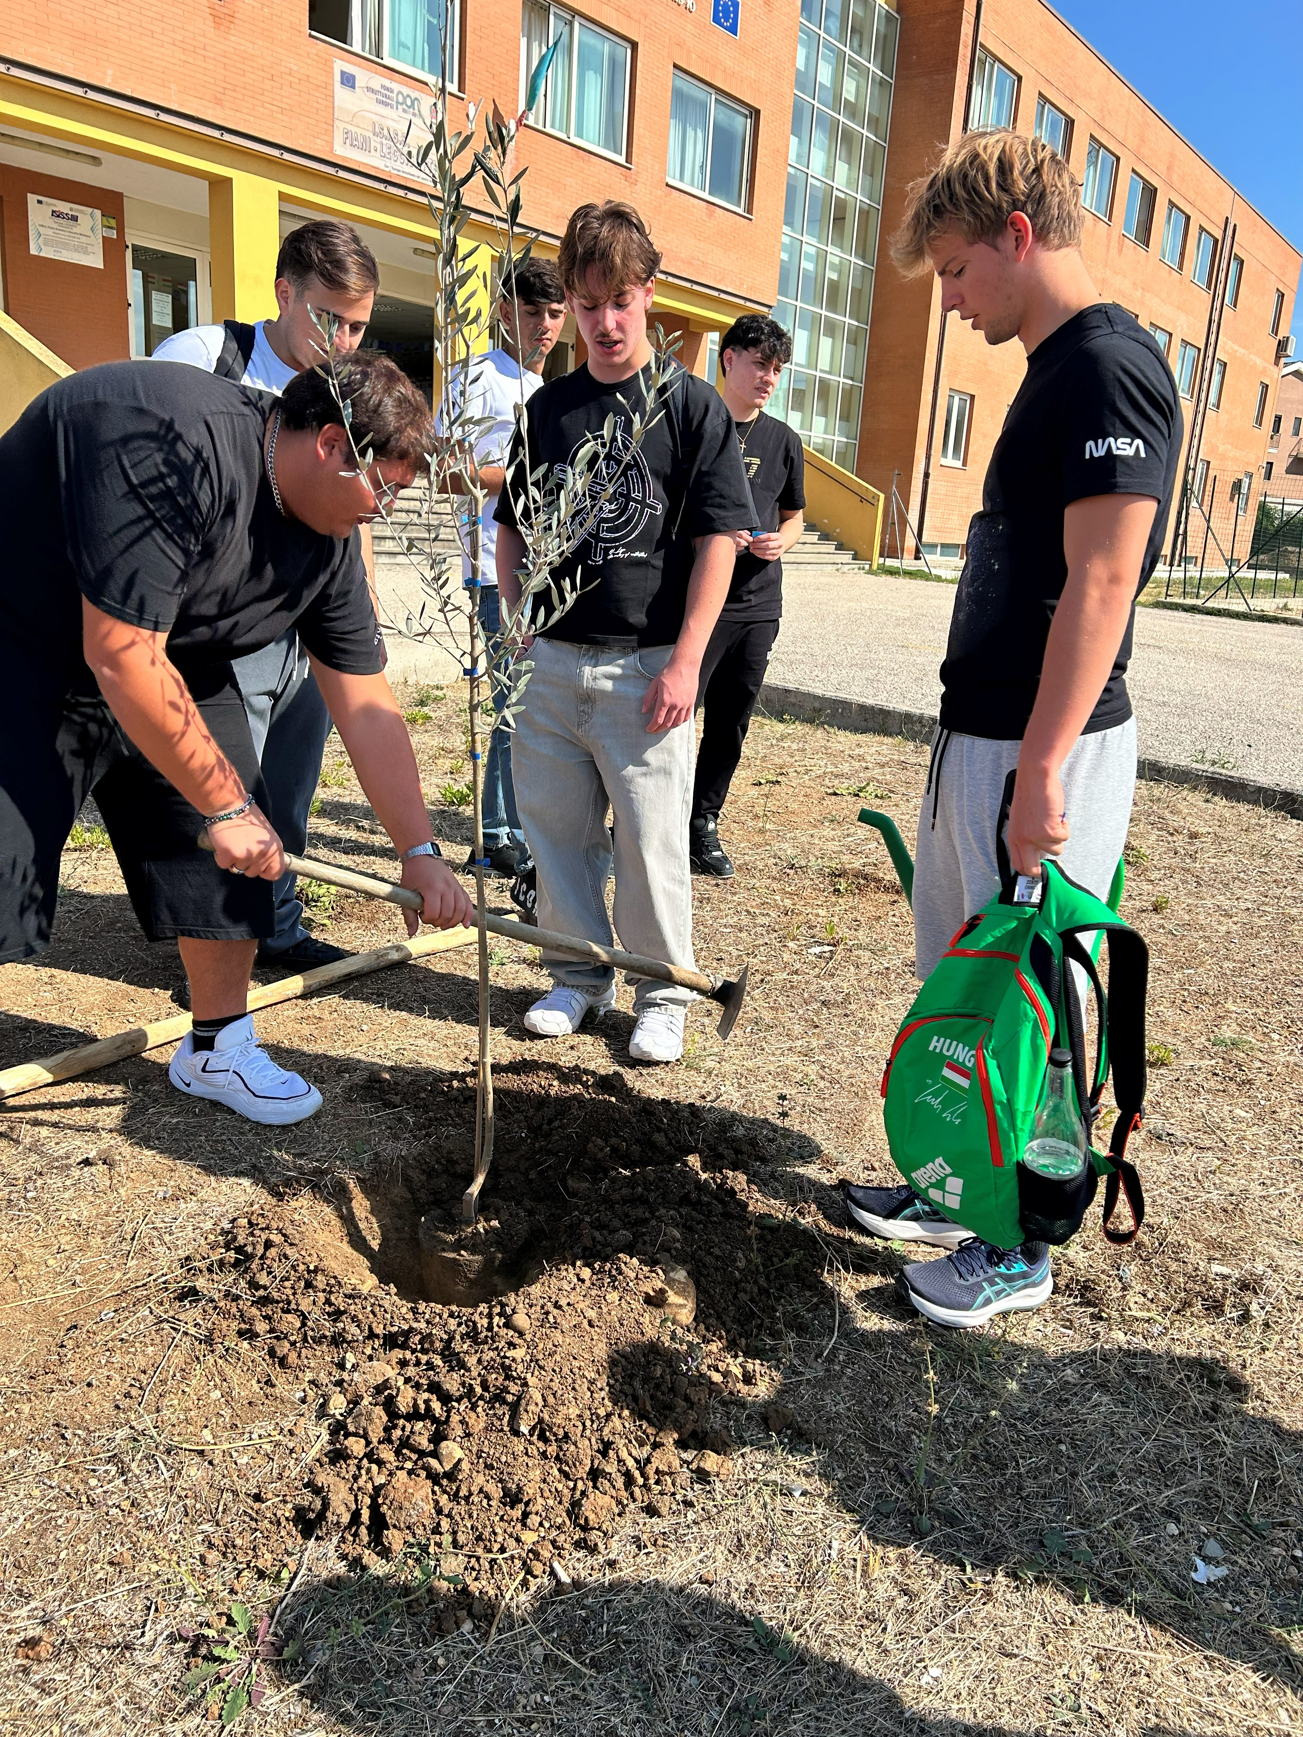
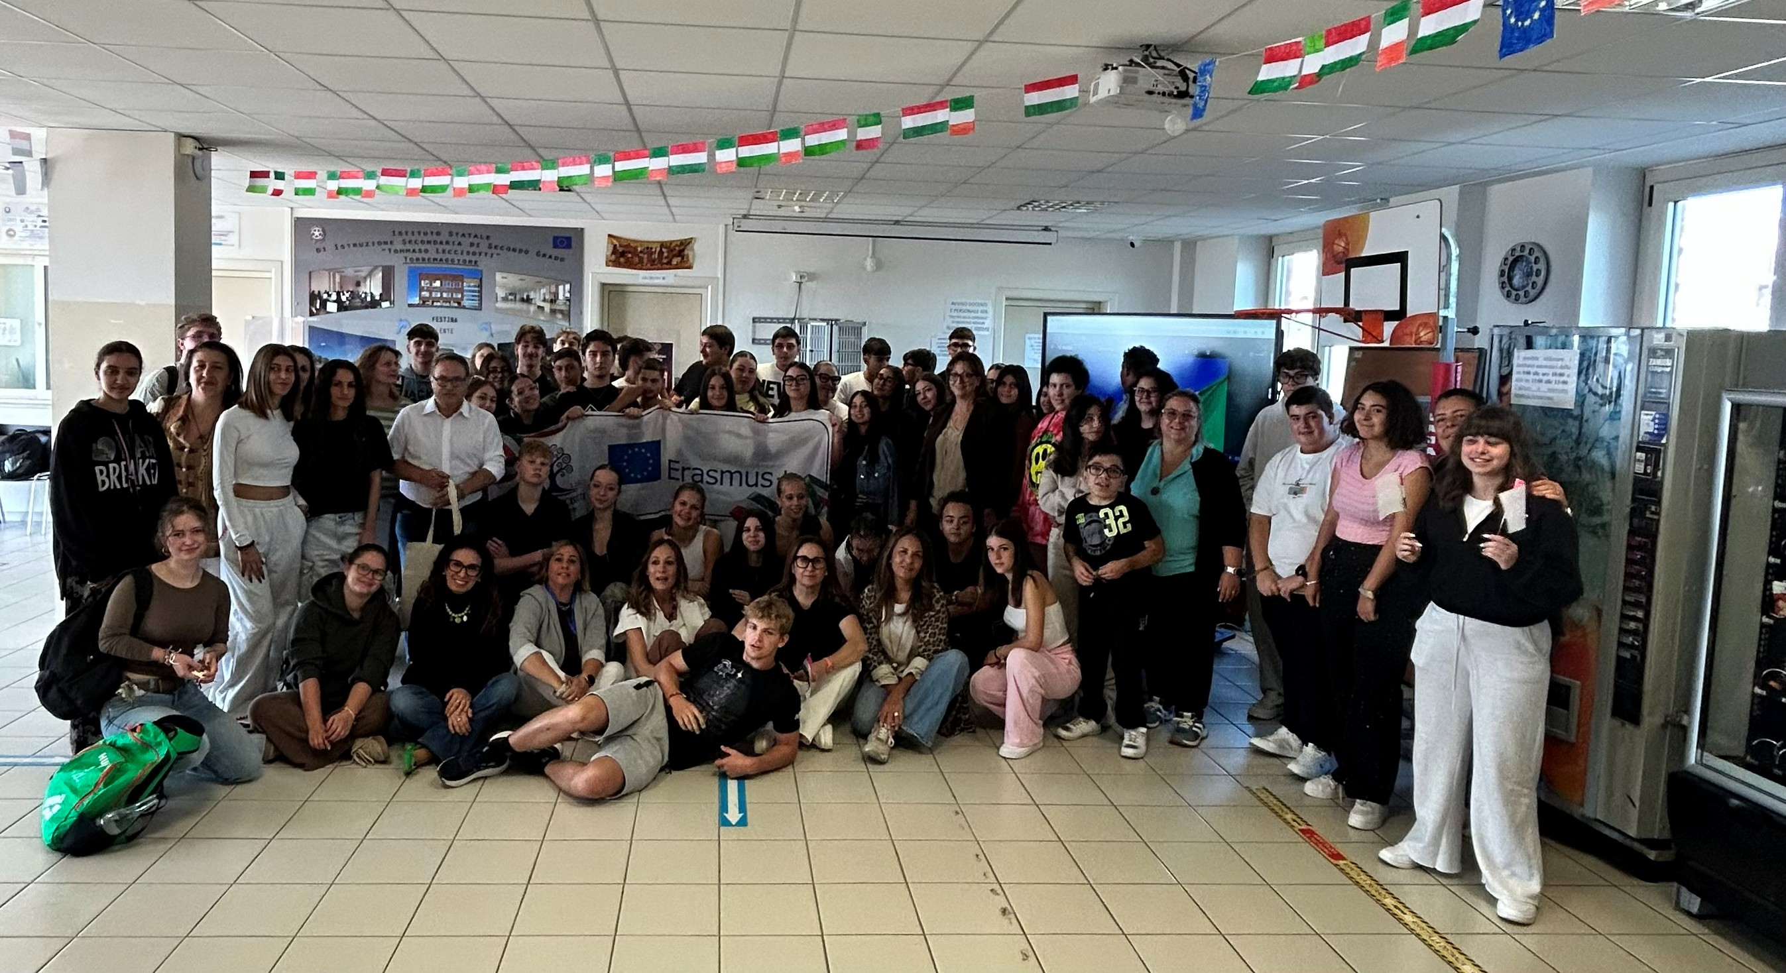

2026-1-HU01-KA121-SCH-000428455
Welcome & Urban Upcycling Launch
Institutional Welcome
School greeting, musical welcome, and official reception by the Mayor of Torremaggiore. Inclusive workshops.
Upcycling Urban Wear Launch
Kicking off fashion redesign and circular economy concepts.
Cultural Discovery
Escape game exploring local traditions and historic sites.
Learning about environmental issues and collaborative work about how
to save the nature for the future.
Sustainability

Slide 5
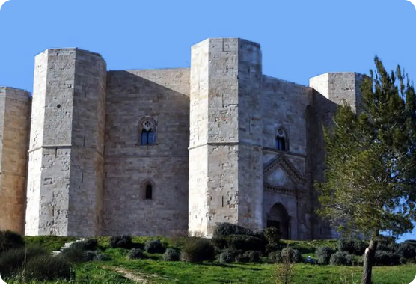
2026-1-HU01-KA121-SCH-000428455
Natural Wonders & UNESCO Heritage
Margherita di Savoia Salt Pan
Europe's largest salt works. Exploring pink waters, salt mountains, and wild flamingos.
Castel del Monte
Guided exploration of Puglia's iconic octagonal UNESCO World Heritage site.

Slide 6
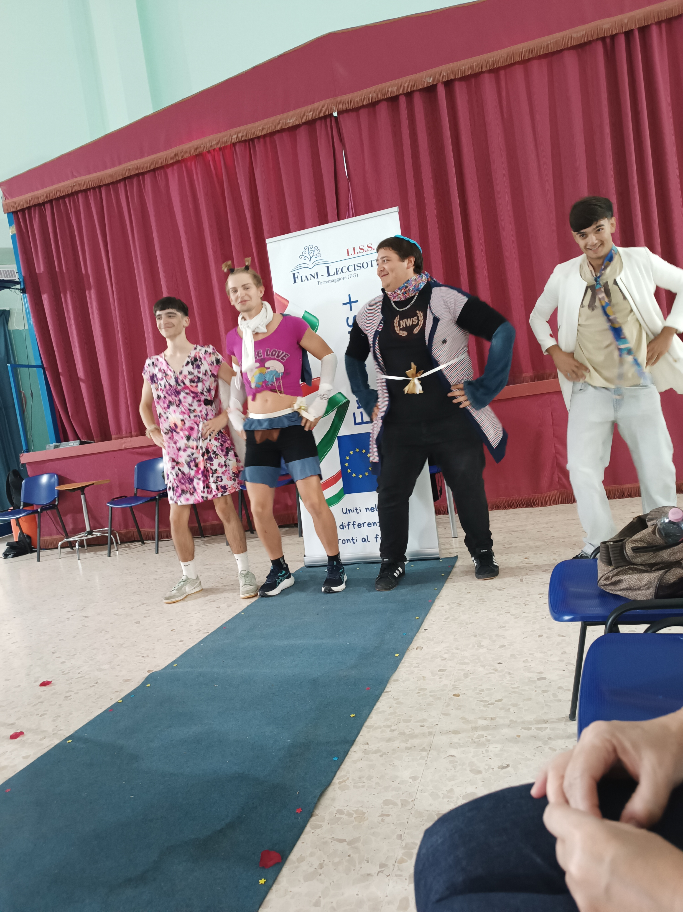
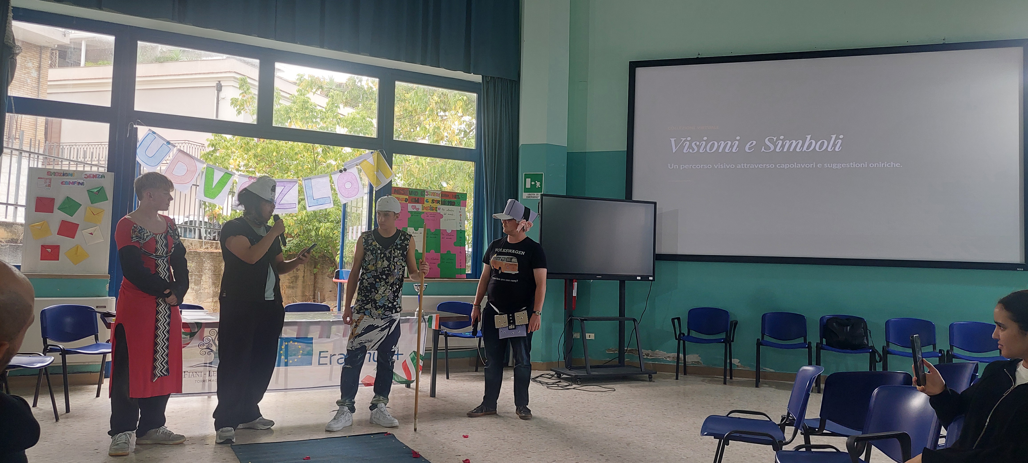
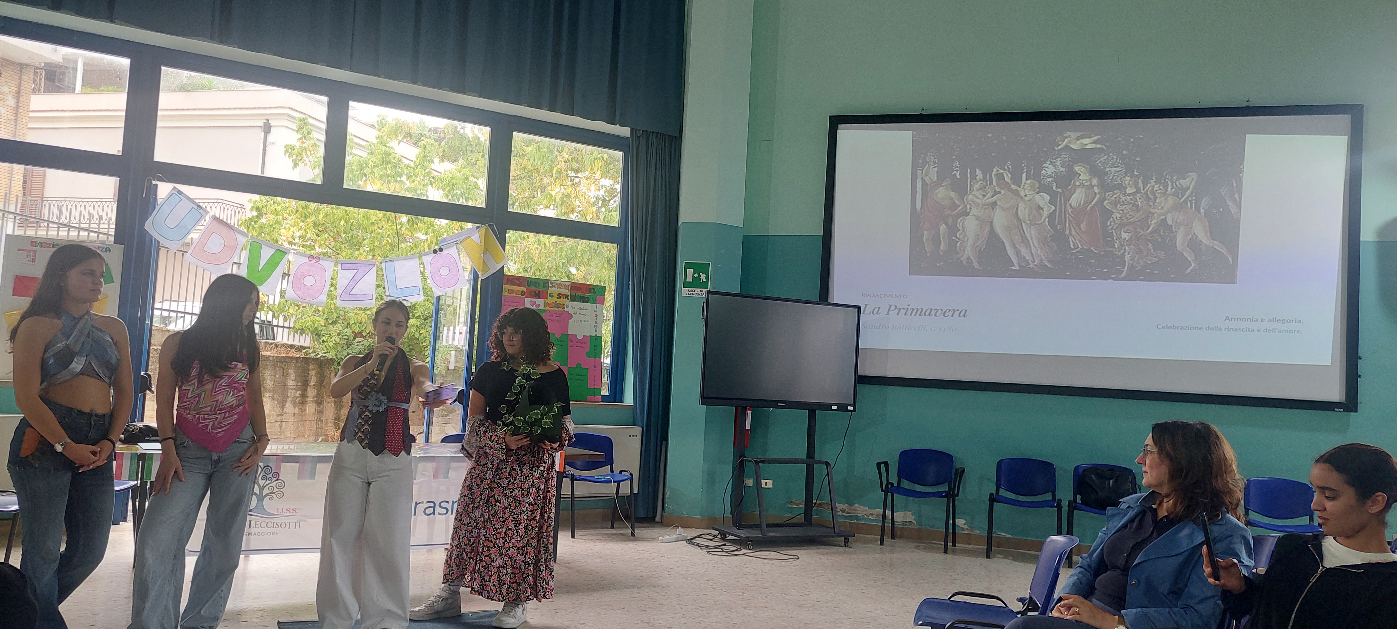
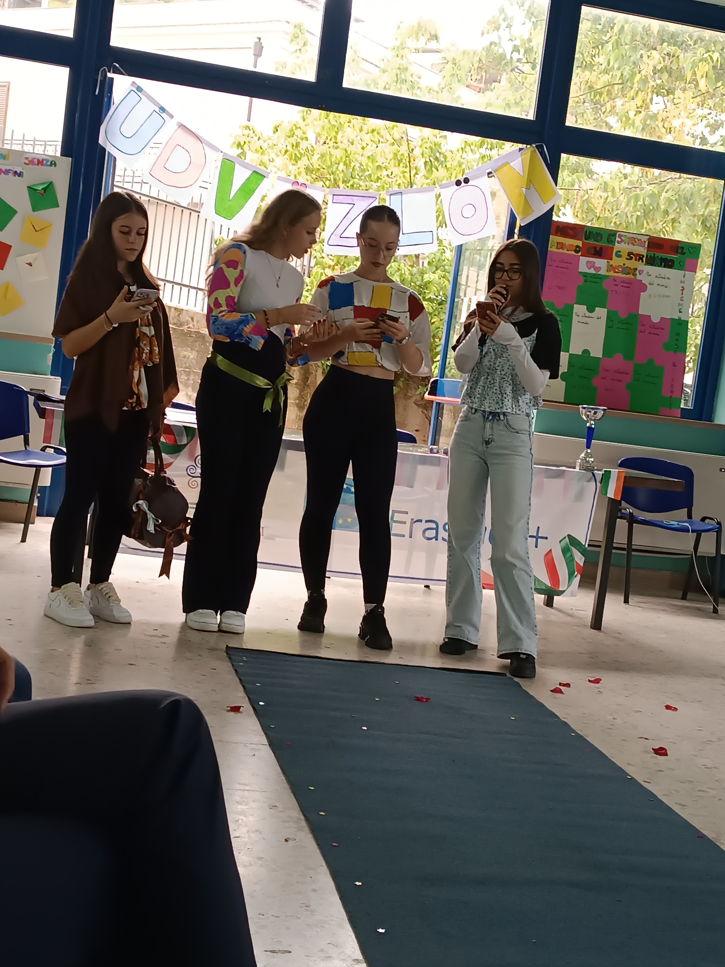
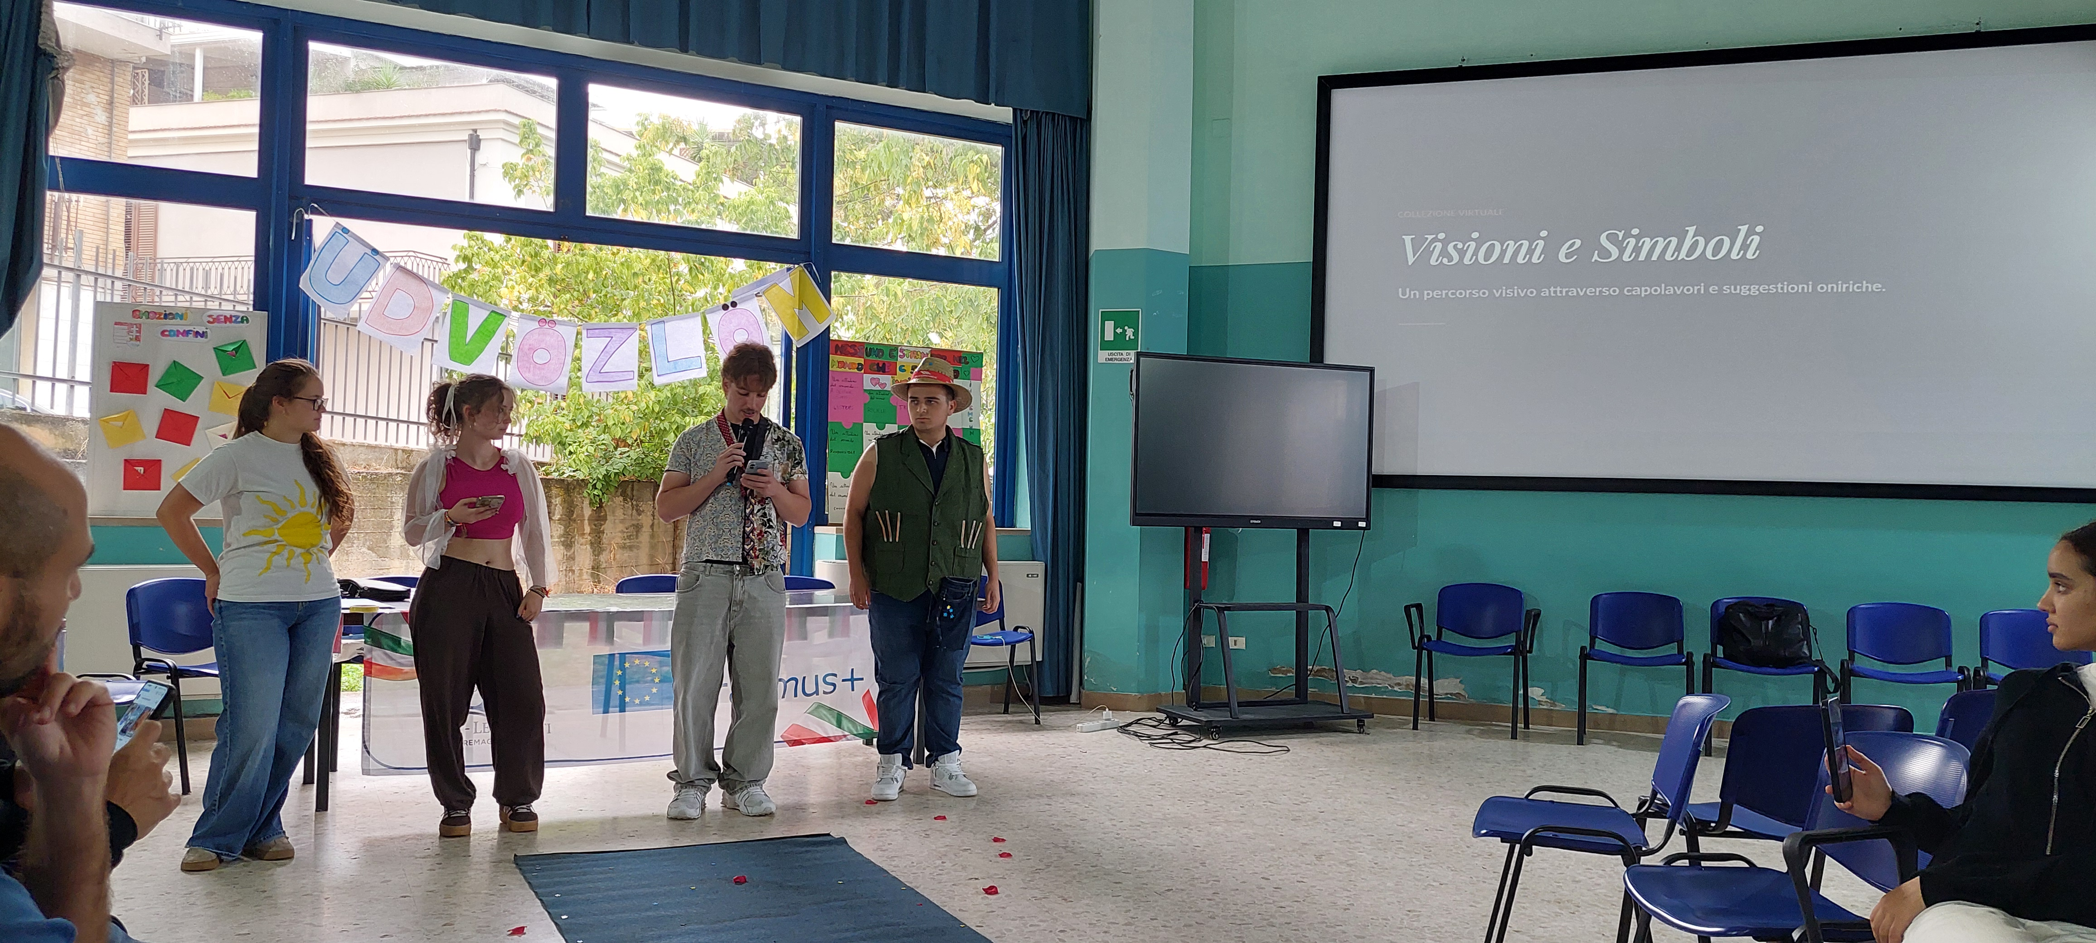
2026-1-HU01-KA121-SCH-000428455
Trash Fashion & ICT Workshops
Campus Greening Action
Planting new trees and greenery at host school campus.
Trash Fashion Workshop
Redesigning pre-owned clothes with creative upcycling techniques.
Canva ICT Presentation
Creating digital portfolios for redesigned garments.

Slide 7
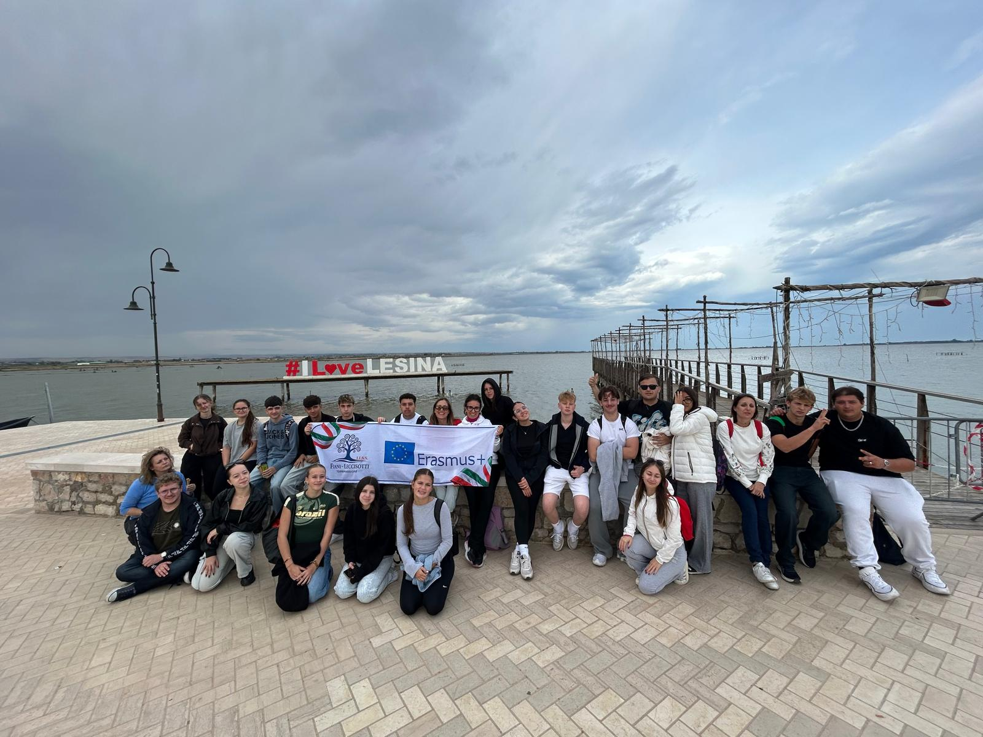
2026-1-HU01-KA121-SCH-000428455
Ecological Discovery at Lesina
Lake Lesina Boat Tour
Exploring coastal lagoon biodiversity and delicate aquatic habitats.
Bosco Isola Nature Walk
Guided eco-trekking through protected coastal woodland reserves.

Slide 8
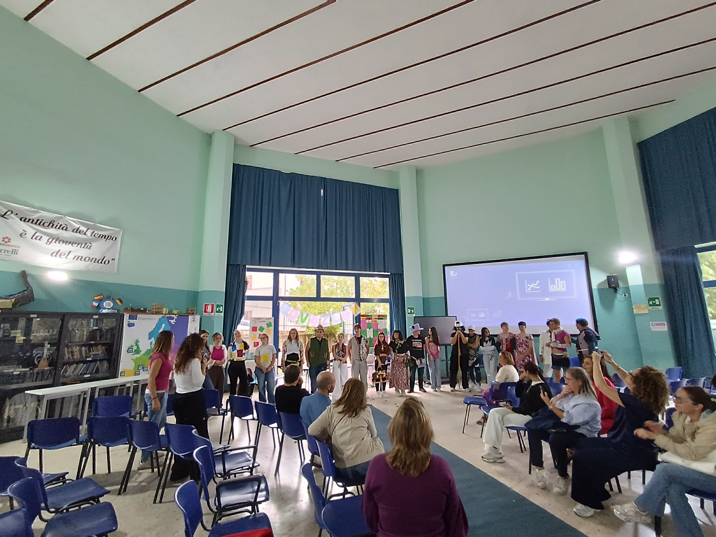
2026-1-HU01-KA121-SCH-000428455
Dissemination & Fashion Show
Final Evaluation & Certificates
Reviewing team project outputs and official award ceremony.
Dissemination Fashion Show
Runway presentation of upcycled outfits for parents, staff, and community.

Slide 9
2026-1-HU01-KA121-SCH-000428455
Key Competencies Developed
Learning outcomes
Green Skills
Digital ICT
Inclusion
Intercultural
Circular fashion & climate action.
Sustainability.
Canva digital storytelling.
Peer equality & joint workshops.
International teamwork & language.

Slide 10

2026-1-HU01-KA121-SCH-000428455
Köszönjük!/Grazie
Csongrádi Batsányi János Gimnázium • ISISS "Fiani - Leccisotti"
Building a Sustainable & Inclusive Future Together

