Slide 1


21o ΓΥΜΝΑΣΙΟ ΠΑΤΡΑΣ
WELCOME TO HELLADA
ERASMUS ACCREDITATION

Slide 2
FACTS
Hellenic Republic Ελληνική Δημοκρατία (Greek) Ellinikí Dimokratía
The country comprises nine geographic regions , and has a population of over 10.4 million.
Athens is the nation's capital and its largest city , followed by Thessaloniki and Patras
Anthem: Ύμνος εις την Ελευθερίαν Ímnos is tin Eleftherían

Slide 3
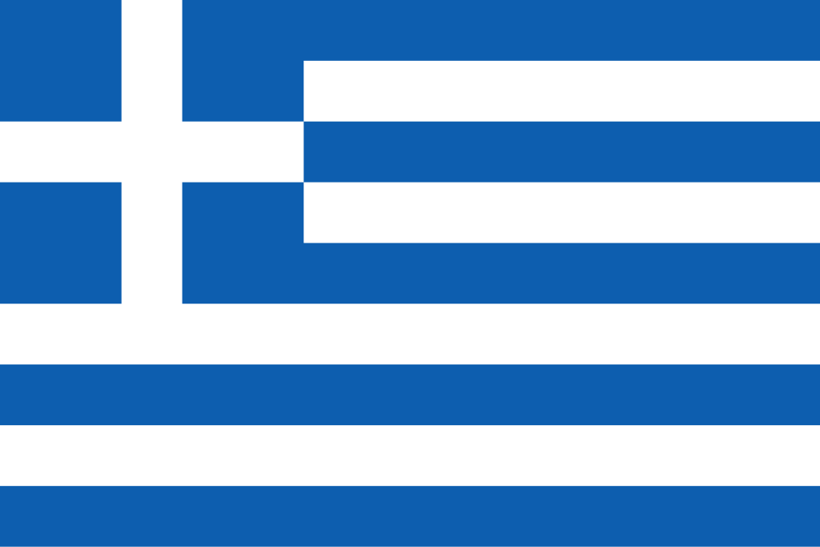

Slide 4
Geography of Greece
Greece is a small country in Europe.
Greece is near the Mediterranean Sea.
The main part of Greece in on a peninsula which is a body of land surrounded by water on three sides.
The rest of Greece is made up of islands There are over 2000 islands that make up the Greek nation. Islands account for around 20% of the country’s land area
Greece is one of the most mountainous countries in Europe
In Greek mythology, Mount Olympus is said to be the seat of the Gods. Mount Olympus is the highest mountain in Greece.

Slide 5
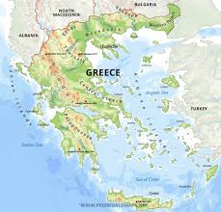

Slide 6
HISTORICAL FACTS
Athens was an important Greek city-state.
Athens became the world’s first democracy around 508 B.C. A democracy is a government in which all citizens can vote and have equal say in what happens.
Sparta was also a Greek city-state.
Sparta was very powerful and had its own army.
Sparta conquered other city-states to gain wealth and power.
There were three classes of people in Sparta. Citizens, non-citizens, and slaves.

Slide 7
PERICLES
Pericles was the leader of creating democracy in Athens.
He had many buildings constructed.
Pericles had the Parthenon and the Acropolis built.

Slide 8
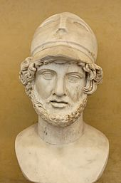

Slide 9
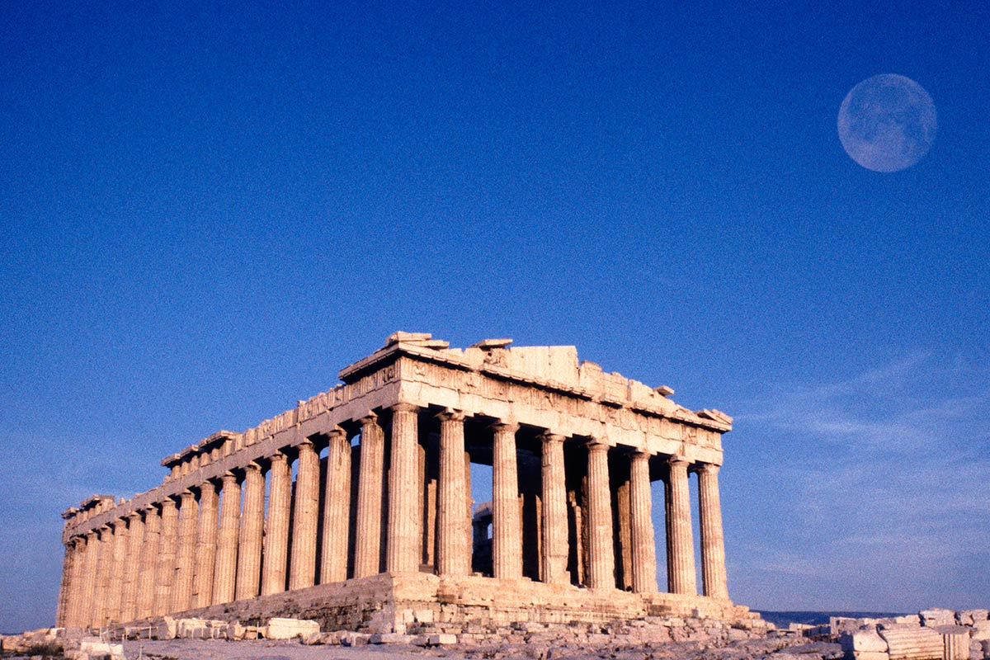

Slide 10
The Greek Alphabet
The Greeks borrowed their alphabet from the Phoenicians.
Most European languages, including English borrowed ideas from the Greek alphabet

Slide 11
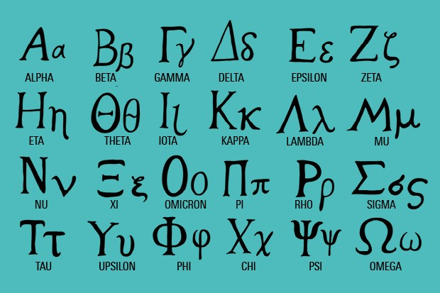

Slide 12
Socrates
Socrates was a philosopher of Ancient Greece.
A philosopher is someone who tries to explain the nature of life.
Socrates taught by by asking questions. This method of questioning is still called the Socratic method.

Slide 13
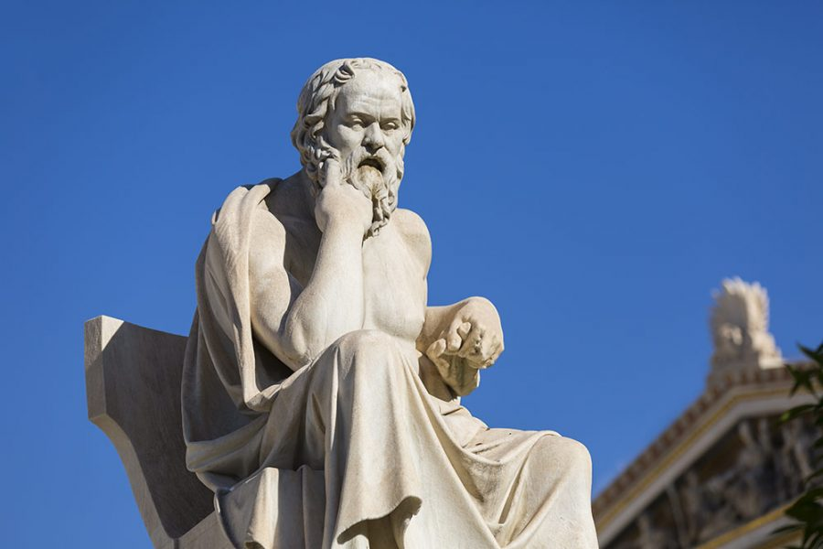

Slide 14
Alexander the Great
Alexander the Great was the son of King Phillip II of Macedonia.
Alexander conquered Persia, Egypt, the Middle East and Northern India.
He died at age 33 from malaria.

Slide 15
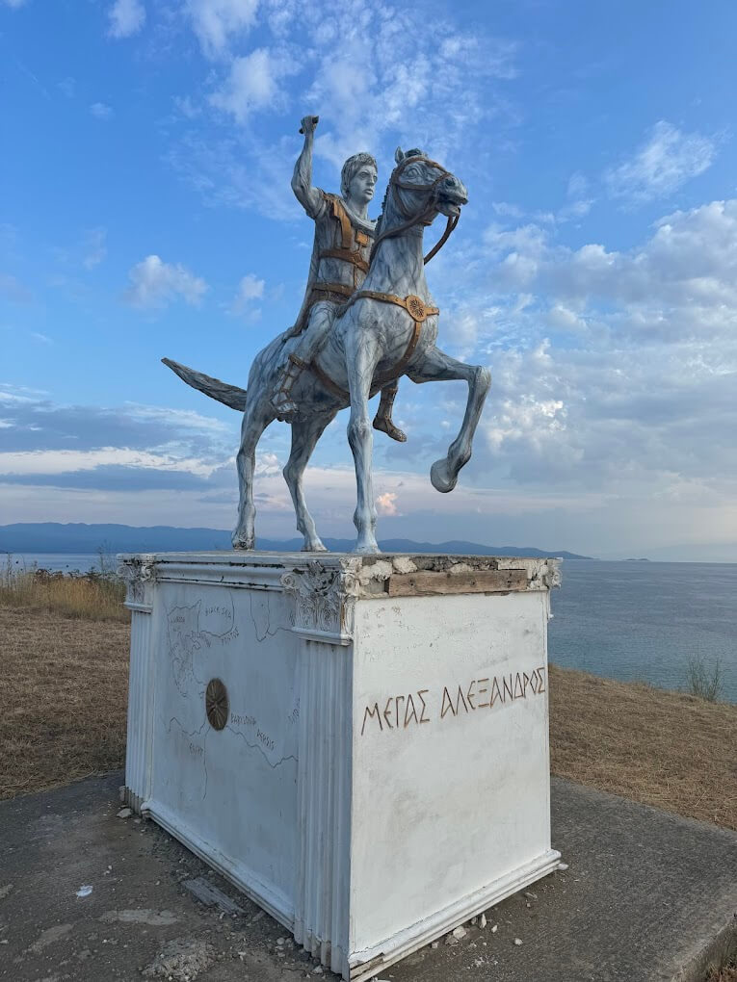

Slide 16
GREEK CUISINE
Greek cuisine is based on ingredients from the Mediterranean like wheat, olive oil, wine, fish, herbs and spices. It has been influenced by Middle Eastern cuisine and has influenced Western cuisines through ancient Rome. Common ingredients include feta cheese, filo pastry, olives, yogurt and honey. Popular dishes include Greek salad, souvlaki, moussaka and spanakopita. Regional cuisines vary but use local vegetables, fruits, herbs and cooking methods.

Slide 17
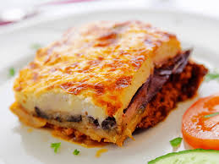

Slide 18
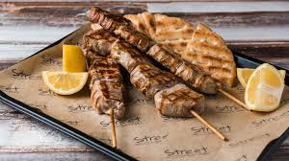

Slide 19
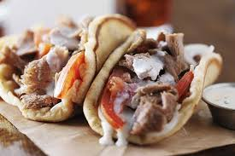

Slide 20
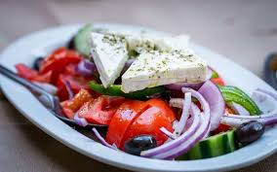

Slide 21
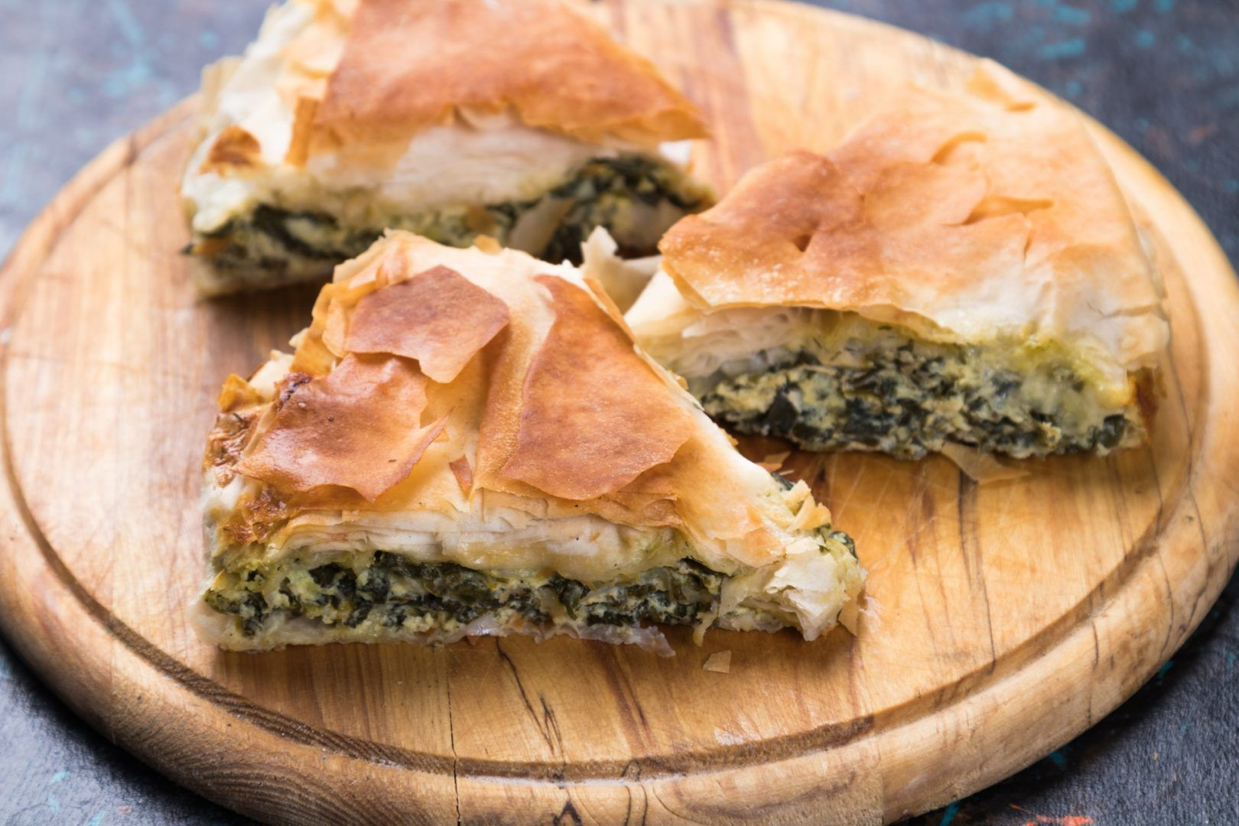

Slide 22
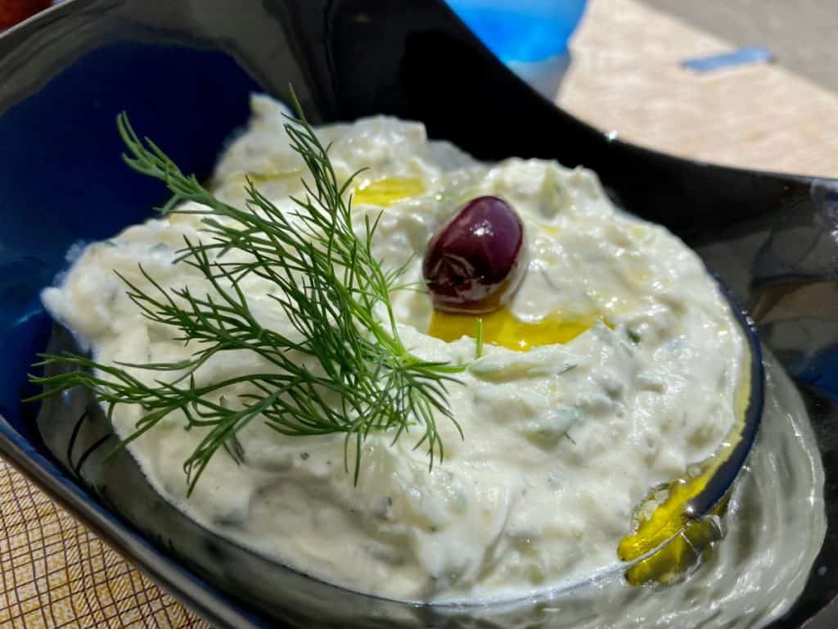

Slide 23
