Slide 1
PATRAS OUR CITY
21 ST LOWER SECONDARY SCHOOL OF PATRAS

Slide 2
OUR CITY
Patras (Greek: Πάτρα), is Greece's third-largest city and the regional capital of Western Greece, in the northern Peloponnese, 215 km west of Athens.
The city is built at the foot of Mount Panachaikon, overlooking the Gulf of Patras, and it is known as the GATE TO THE WEST.
The Rio-Antirio Bridge connects the Peloponnese peninsula with mainland Greece.
In the Roman period, it had become a cosmopolitan center of the eastern Mediterranean whilst, according to the Christian tradition, it was also the place of Saint Andrew's martyrdom.
The city has three public universities, hosting a large student population and rendering Patras an important scientific centre.

Slide 3
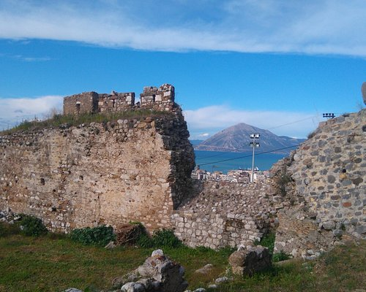
THE CASTLE OVERLOOKING THE SEA

Slide 4
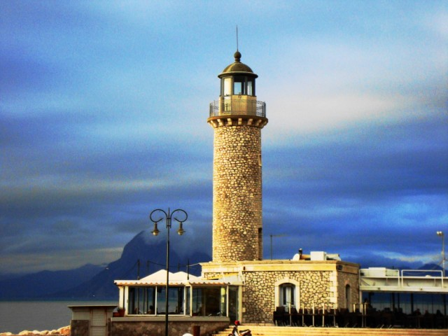
THE LIGHTHOUSE

Slide 5
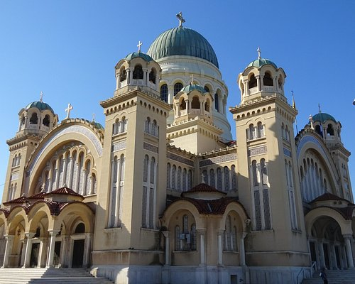
ST ANDREW CATHEDRAL

Slide 6
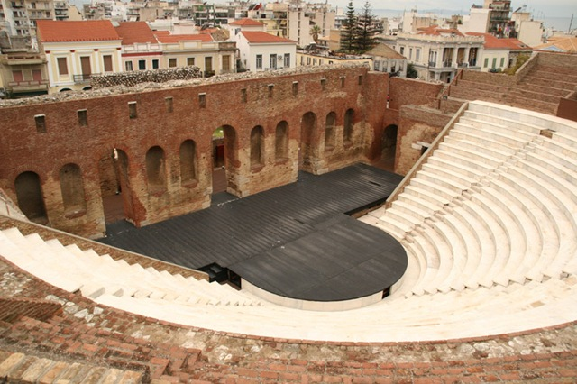
THE ROMAN THEATER

Slide 7
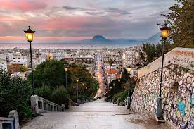
ST NICOLAS STEPS OVERLOOKING THE CITY

Slide 8
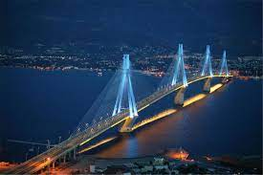
THE BRIDGE RIO- ANTIRIO

Slide 9
THE CARNIVAL
Every year, in February, the city hosts one of Europe's largest carnivals including balls and parades, enjoyed by hundreds of thousands of visitors in a Mediterranean climate.
It was European Capital of Culture in 2006.^{[3]}

Slide 10
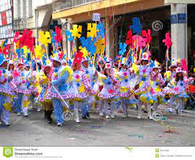
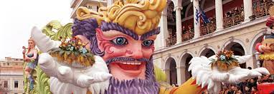
THE CARNIVAL

Slide 11
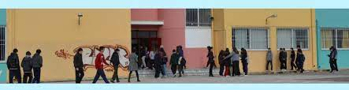
OUR SCHOOL-
Our school is called the 21st gymnasium of Patras
It is located near the center very close to the archeological museum
Currently, there are 240 students aged from 12- 15 years old

Slide 12
BUILDING
It includes 13 classrooms, a Library, a well-equipped Informatics room, as well as an Artistic one, Technology, Physics and Chemistry laboratories, while at the entrance of the school is the spacious and technologically equipped auditorium. On the ground floor there is a canteen, while in the courtyard, which surrounds the building, there is an indoor gym and organized, basketball and volleyball courts. In the courtyard, the garden of the school was formed, with the care of students and teachers, while there are trees around the perimeter, something that cultivates their ecological consciousnes

Slide 13
AIMS
Our school’ s development planning aims social inclusion, diversity, equality, gender balance and non-discrimination in the fields of education and promotes the acquisition of skills and competencies outdoor, and, of course, it is a continuous process.. Our whole learning community is involved in this process and helping to build capacity for future improvement.

Slide 14
ACTIVITIES
We take part in various activities such as environmental, health education and cultural programs.
We also organize various outings and outdoor activities as well as invite specialists in our school and we celebrate international days.

Slide 15
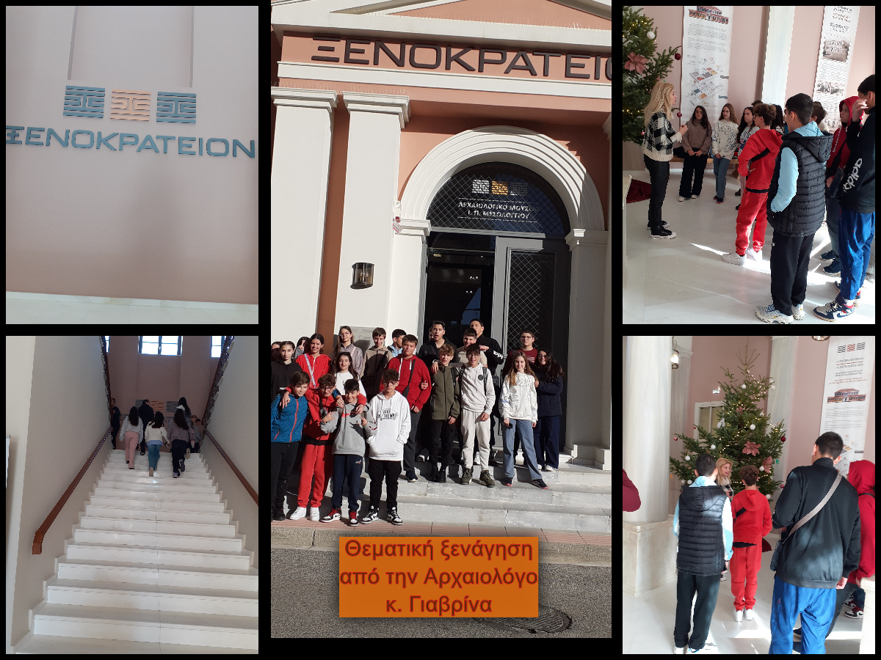
MESSOLOGGI

Slide 16
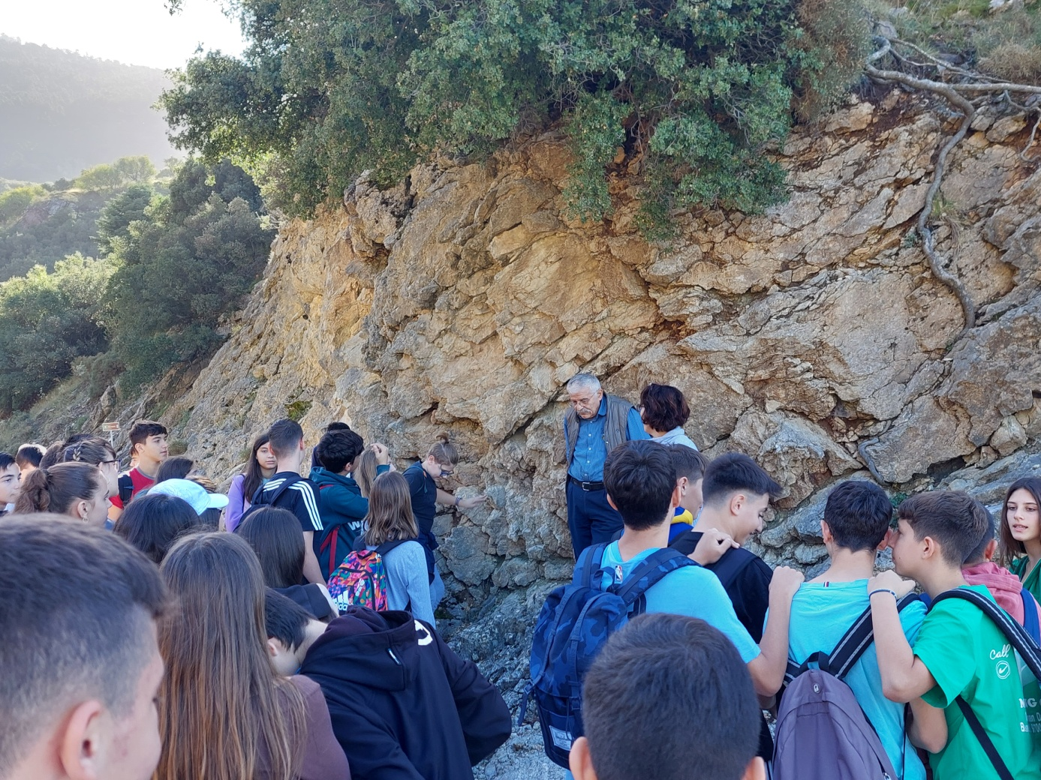
POURNAROKASTRO

Slide 17
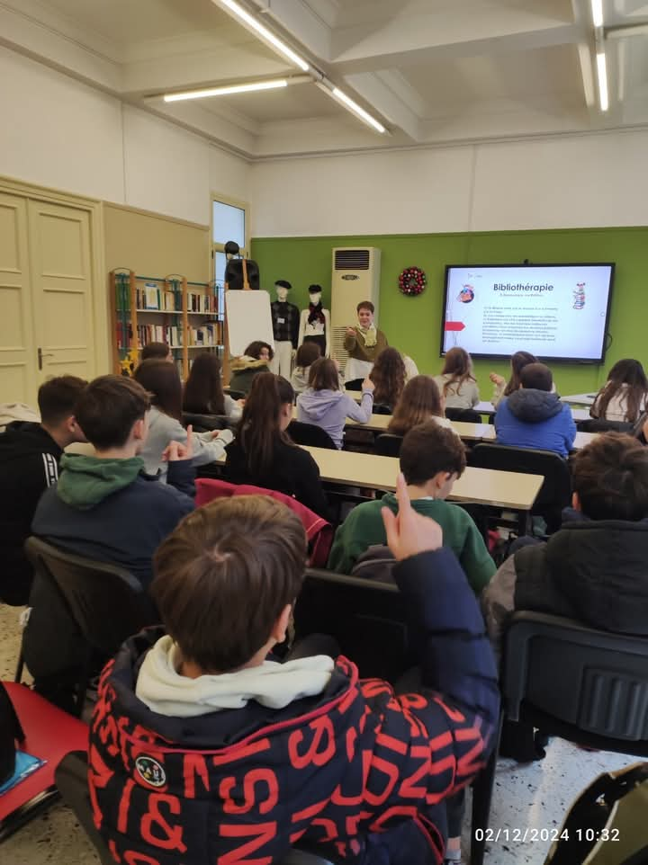
FRENCH INSTITUTE

Slide 18
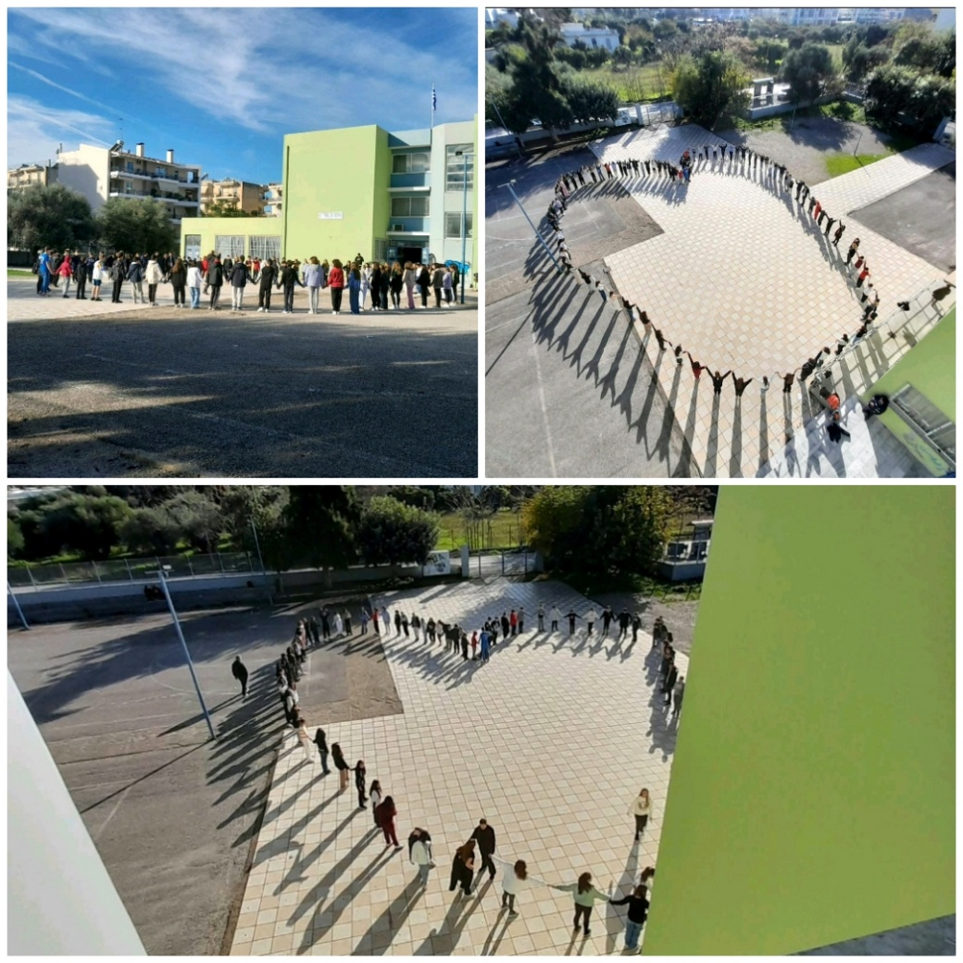
INTERNATIONAL DAY OF SPECIAL NEEDS

Slide 19
CULTURAL ACTIVITIES PAINTING OUR SCHOOL
https://www.youtube.com/watch?v=bjCGgHw2eTI

