Slide 1
How to make a ‘Marti’ bracelet
21 Ο ΓΥΜΝΑΣΙΟ ΠΑΤΡΑΣ

Slide 2
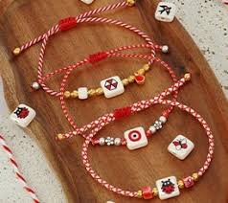

Slide 3


Slide 4
WHAT IS IT
The “Marti bracelet” is an ancient custom for the beginning of Spring.
According to tradition, the bracelets are worn for the entire month of March for good luck or more specifically to protect people, youngsters especially, from getting sunburn during March which is considered the first month of spring in Greece.
The colour of the bracelets is red and white, symbolising rosy cheeks and a white complexion.

Slide 5
HOW TO MAKE IT
Today, we share one (simple) way you can make your own ‘Marti bracelet’.
What you will need:
Red thread
White thread
Tape
Scissors

Slide 6
HOW TO MAKE IT
Steps:
Cut 2 strands of white thread, about 60cm each.
Cut a 60cm strand of red thread.
Gather the ends of your strings together. Treating them as a single strand, coil them into a loop, then pull the ends through the loop. This will make the knot.
Tape the string above the knot to a flat surface, such as a table or board.
Start the braid.
Maintain a consistent tension. Give the strings a gentle tug to tighten the strings as you braid.
Fasten the braid end into a knot. Coil the braid end into a loop, then pull the tails through the loop. Tug on the tails to tighten the knot.
Snip off the leftover threads.
Remove the tape from the start of the braid.
Wrap the braid around your wrist and tie the ends together into a double-knot.

Slide 7
https://greekcitytimes.com/2021/03/01/how-to-make-marti-bracelet/

