Slide 1
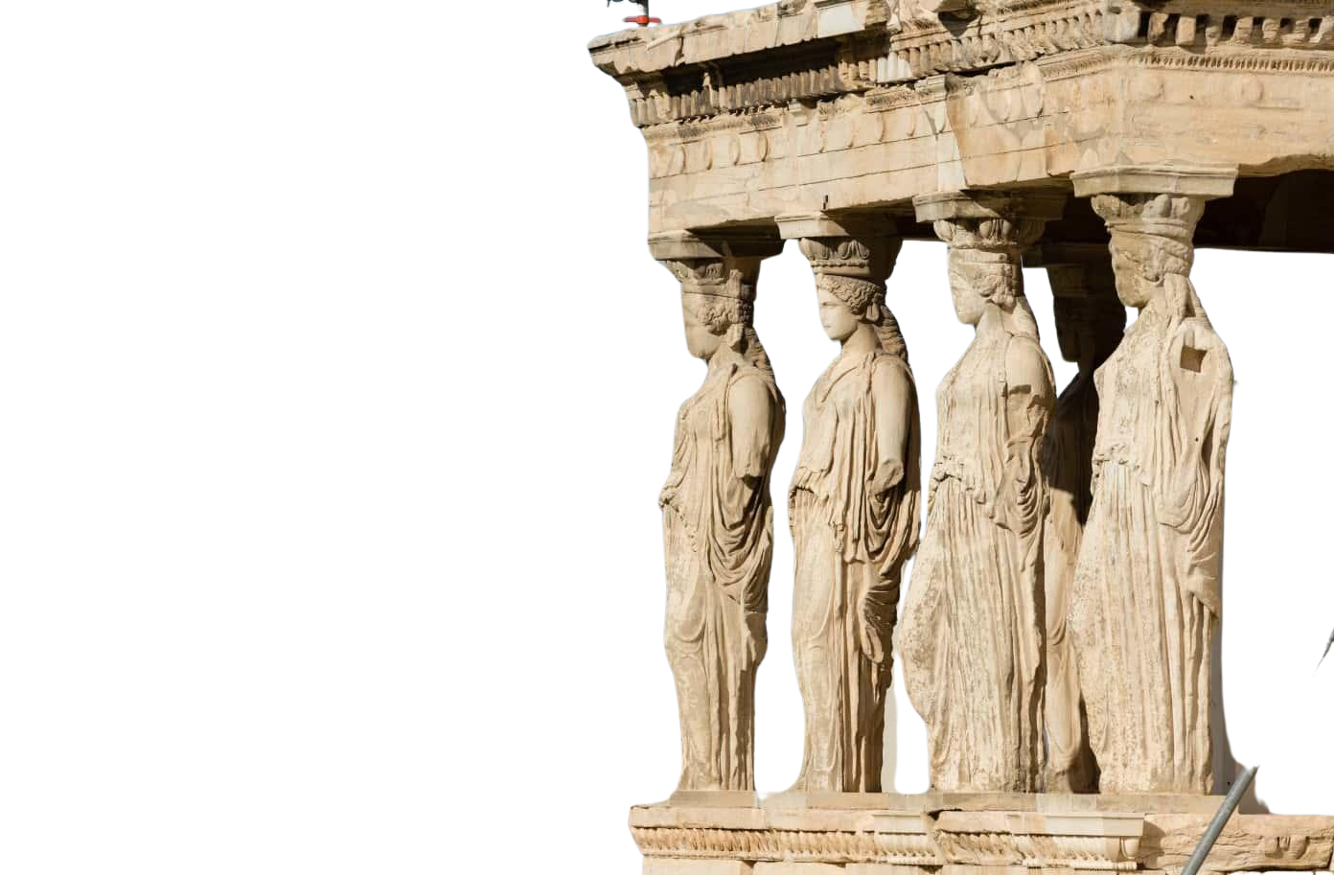


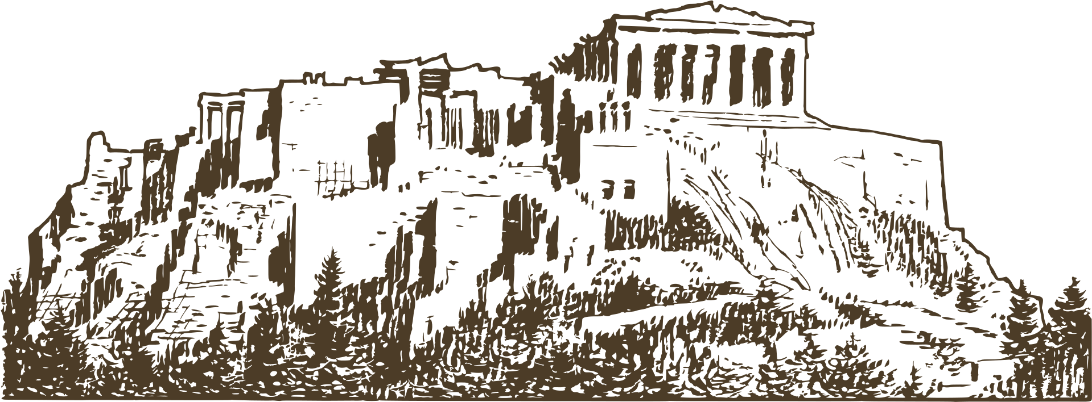
ANCIENT GREECE
A Journey Through History, Culture, and Legends
2025-1-HU01-KA121-SCH-000333716
1

Slide 2
ANCIENT GREECE
A Journey Through History, Culture, and Legends
2

Slide 3
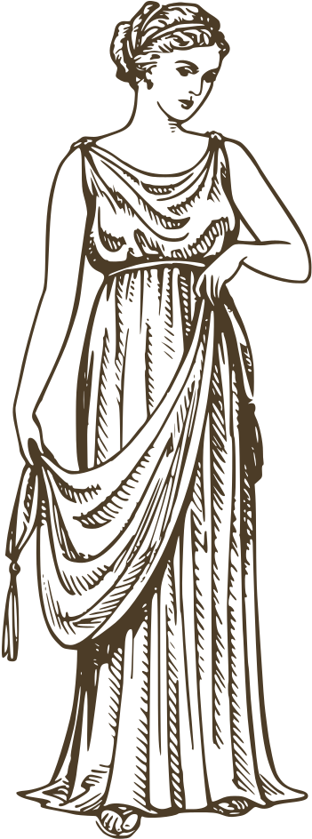
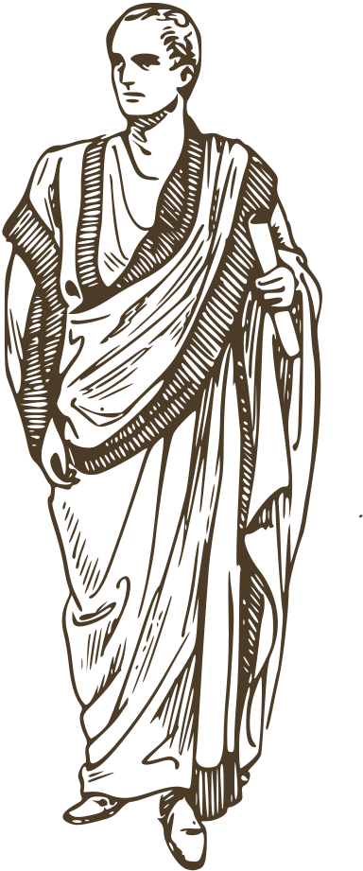
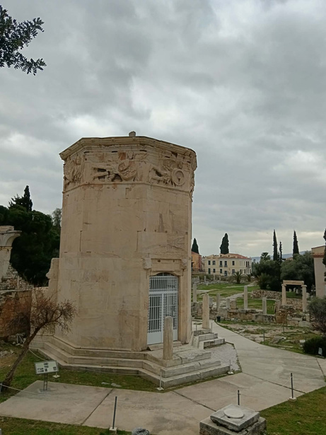
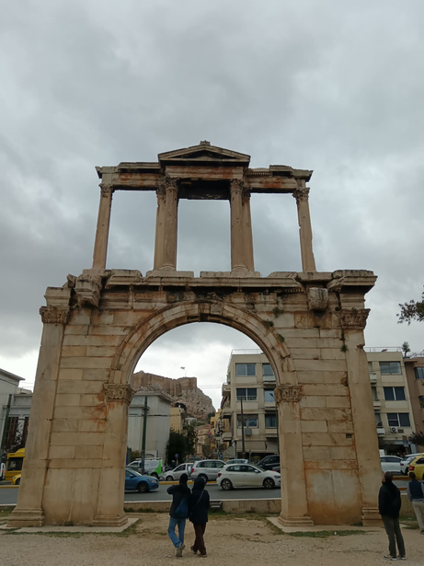
INTRODUTION
The birth of an extraordinary civilization
There is no person on earth who has not already heard of the Greeks. There are those who know characteristic Greek buildings, or some characters from the myths. However, this is only a small slice of their history. And there is still so much we don't know. bUT
3

Slide 4
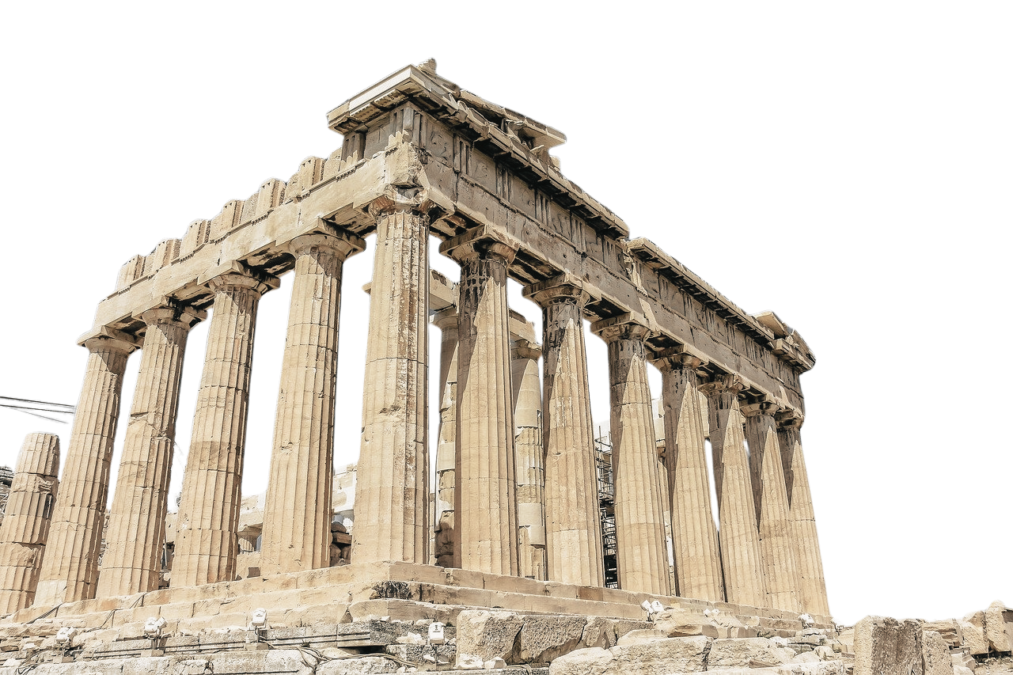
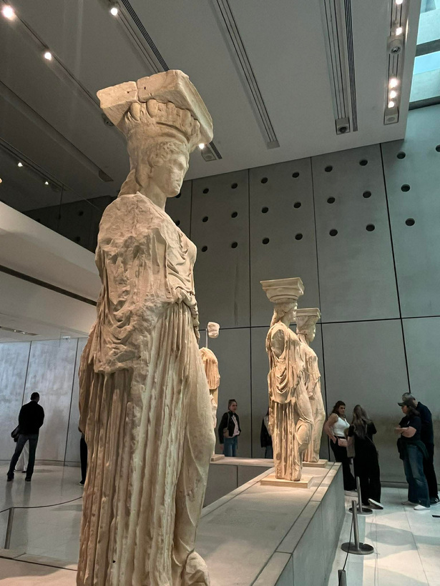
ANCIENT GREECE
There was no area in life where the Greeks were not good. There were orators, poets, writers, warriors, philosophers. They were curious, so they researched what humanity had not attempted before.
4

Slide 5
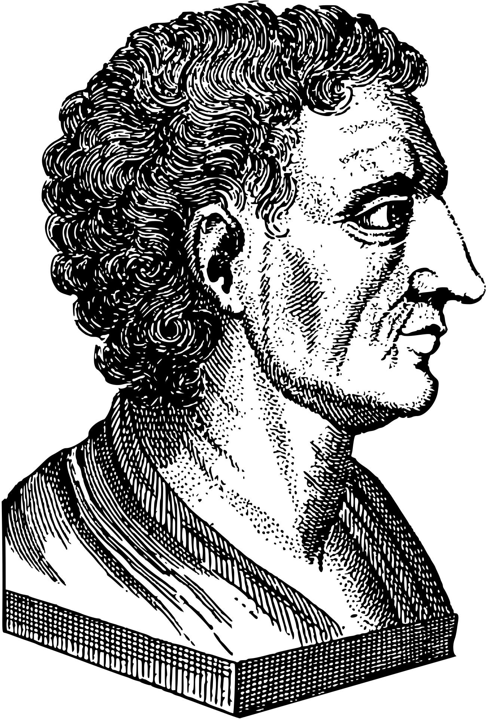
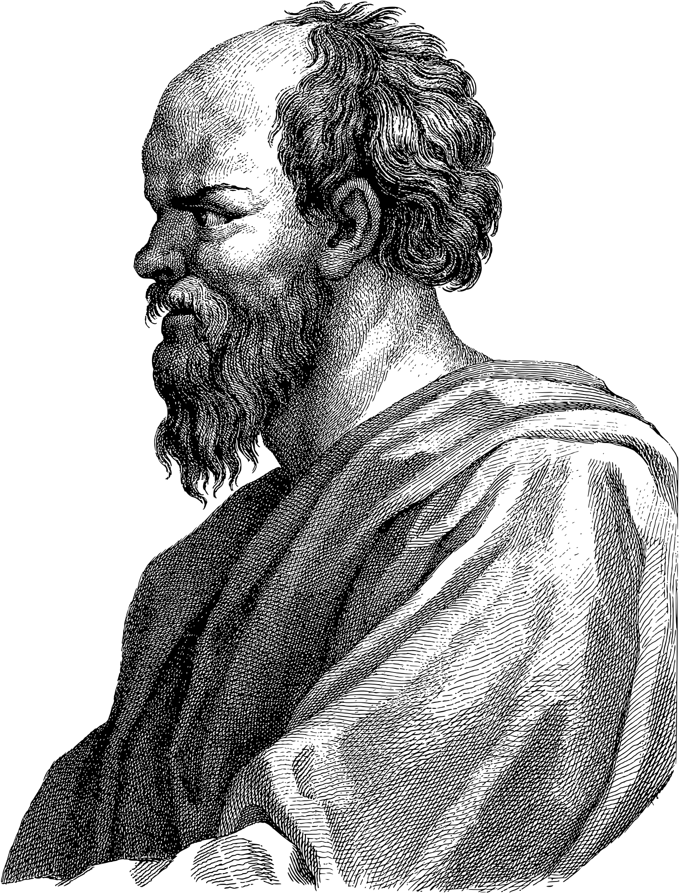
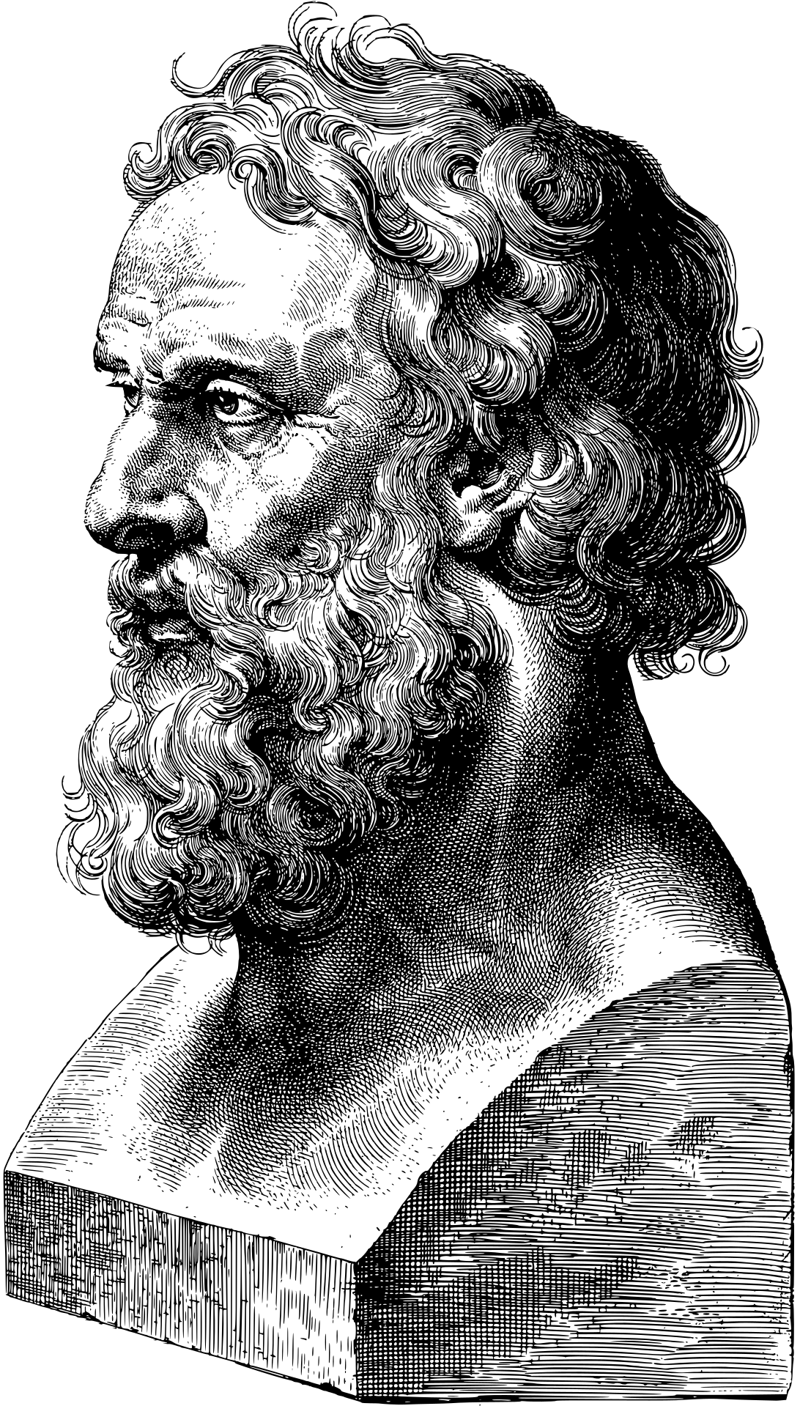
PHILOSOPHY AND CULTURE
Greek thought and the birth of rationality
People have always search some explanation for the events that happen in nature and in their lives. In the life of the Greek people, myths have always played an important role. And thanks to those who wrote down these stories, we have been able to learn a lot about the thinking and beliefs of people at that time.
In the architecture, we can also see how importanat for the Greek people the gods and godnesses. They built temples and statues to them.
The characteristic Greek motifs also appear in today's architecture.
Many philosophers grew up in this country.
For example Socrates, Platon and Aristotle.
They all played an important role in the formation of today's views.
5

Slide 6
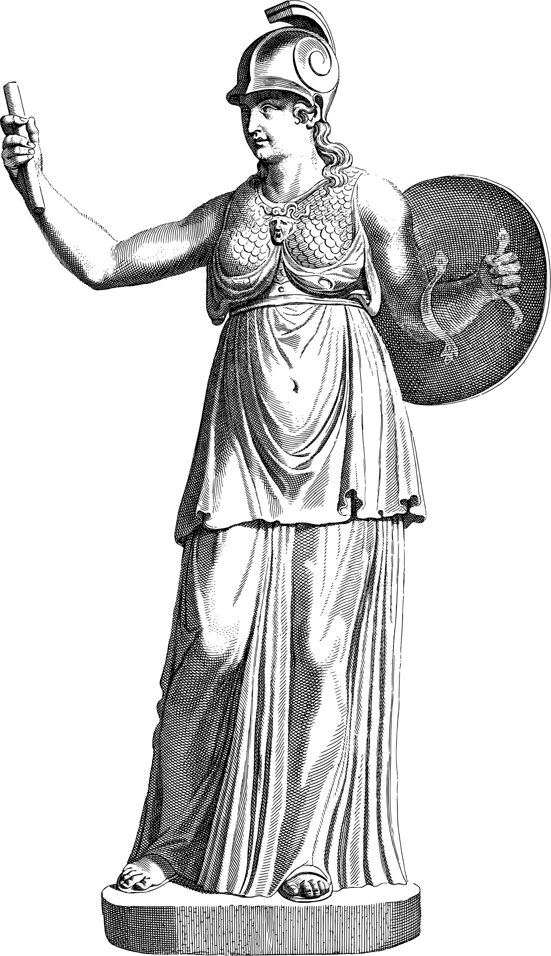
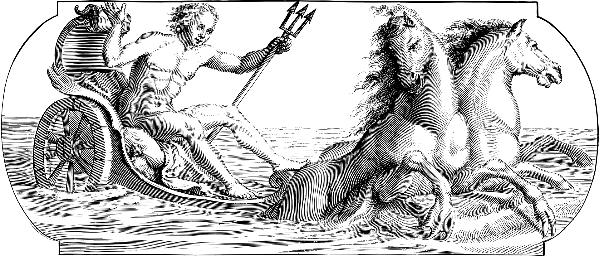
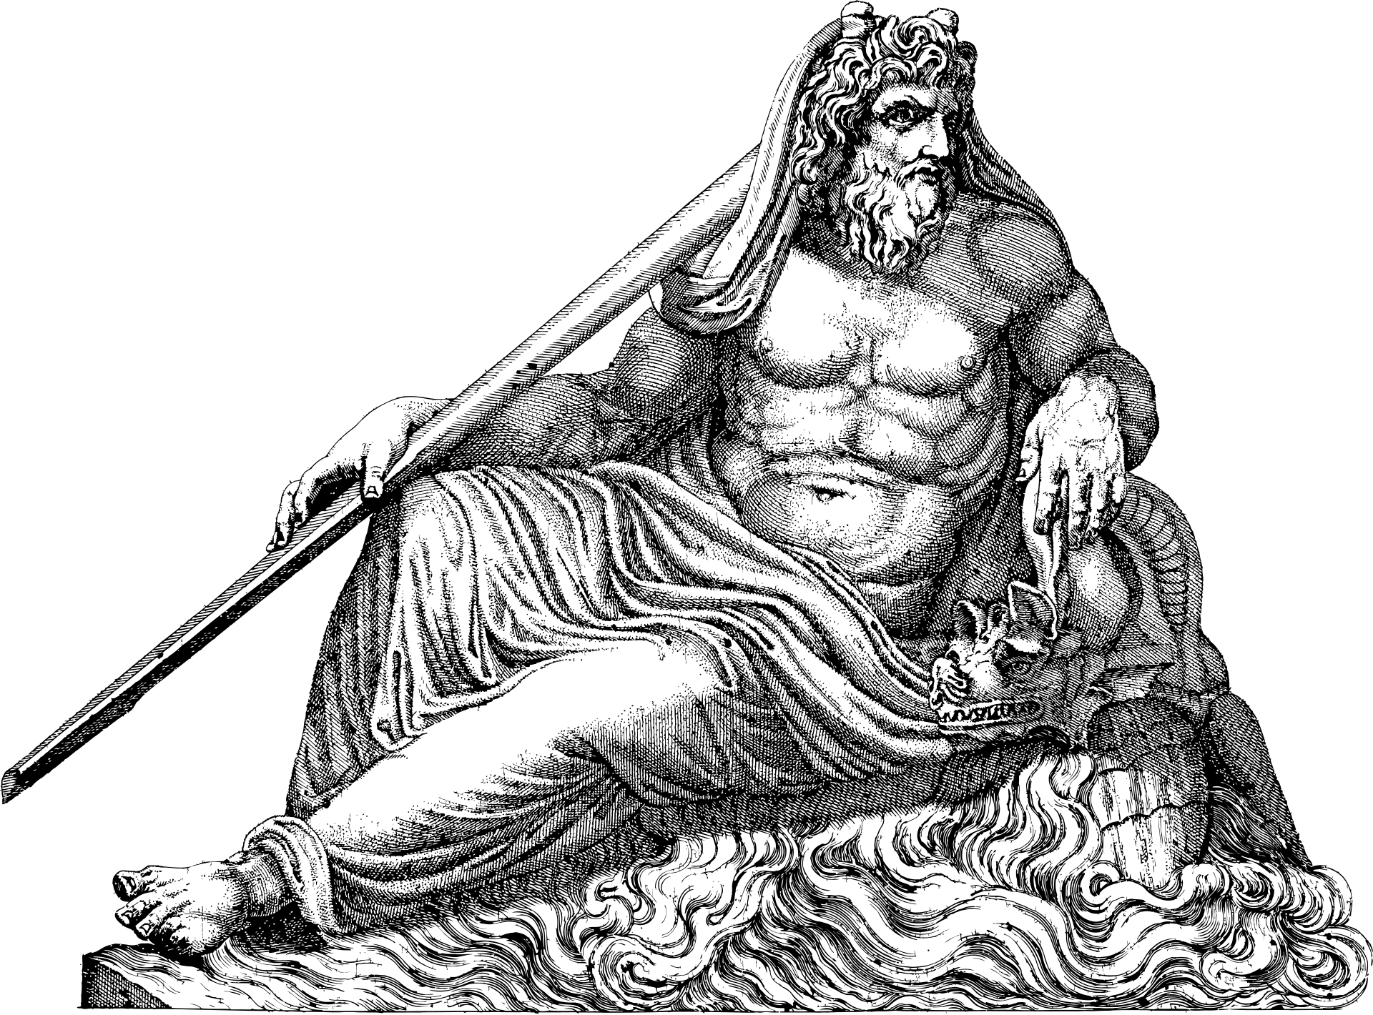
MYTHOLOGY AND RELIGION
The gods of Olympus and the role of myths
ZEUS
ATHENA
POSEIDON
In the Greek mythology Zeus is the main god. He is the god of storms and lightning.
Athéna is the godness of wisdom, law and just war. She spranged from her father’s head in full armor.
Poseidon is Zeus’s brother. He is the god of oceans, seas, rivers and earthquakes. One of his charachteristic tool is the trident.
6

Slide 7
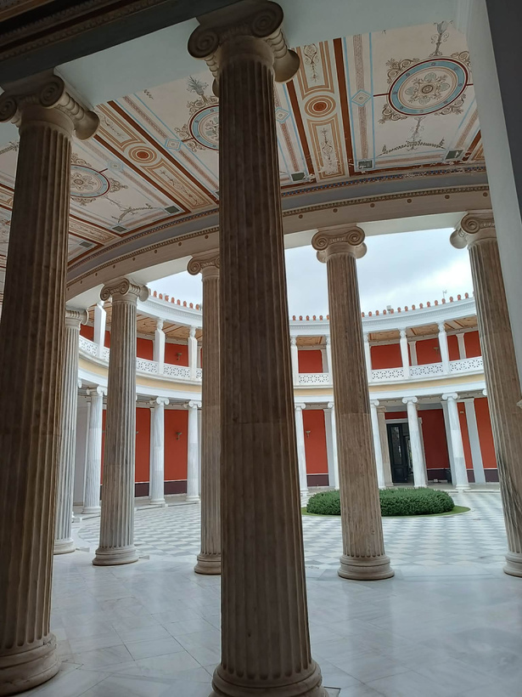
THE POLIS AND POLITICS
Democracy, oligarchy, and monarchy compared
ATHENS
SPARTA
OTHER CITY-STATES (POLEIS)
Athén is in the southwestern area of the Attic peninsula. This city is the capital of Greec.
Current population is 643 452. So many mythological stories related to Athens, for example the war between Poseidon and Athéna over who the people of Athens would love more.
Sparta was on the Attic peninsula too, but it was in the southeastern area of the Attic peninsula.
In this city, there was the strictest and thoughest military training. Boys were raised in military camps from the age of six.
Importatnt citys for example Delpoi, Patras, Larisa and Mycenae.
7

Slide 8
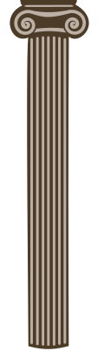
ART AND ARCHITECTURE
Harmony and perfection in forms
DORIC
IONIC
CORINTHIAN
Trick and strong appearce,no base,simple,undecoratedc capital,vertical grooves along the shaft,symbolizes strenght and stability
slender and taller shape,has base,the capital has spiral scrolls,more detailed and refined desing,symbolizes elegance and sophisticaiton
tall and slender shape,has base,the capital is richly decorated whit acanthus leaves,highly detailed and ornamental desing,symbolizes beauty and luxury
8

Slide 9
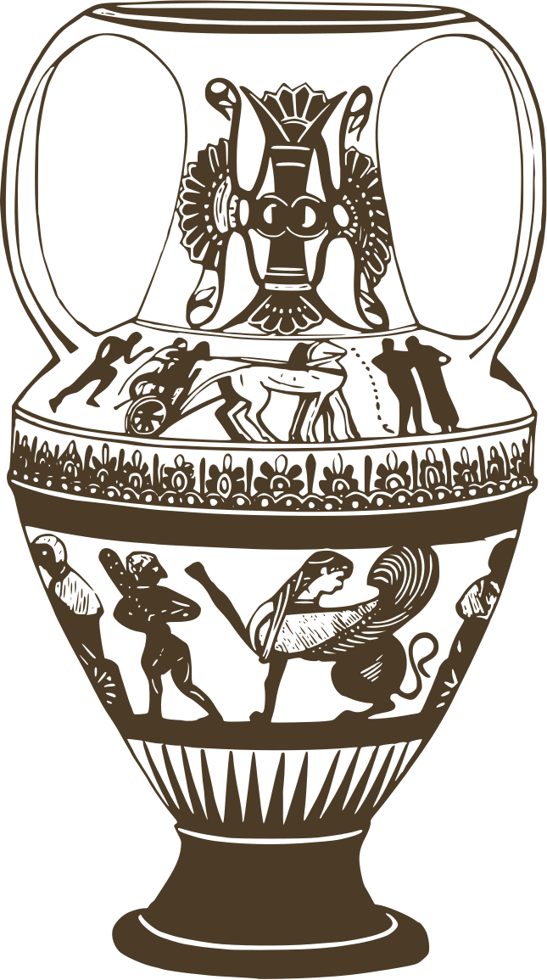
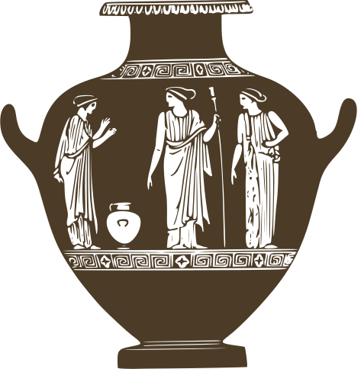
LITERATURE
AND EPIC
Immortal tales of heroes
THE ILIAD AND THE ODYSSEY
homer wrote two famous epics,the Iliad and the Odysseus.The Iliad tells the story of the Trojen War,while the odyssey follows the adventures of odysseus
THE TRAGEDIES
Greek tragedies dealt whit serious themes shuch as fate,the will of the gods,and human flaws. famous wrieters include Sophocles and Euripideas
THE COMEDIES
comedies werw humorous and often mocked politics and society. The most famous writer was Aristophanes.
9

Slide 10
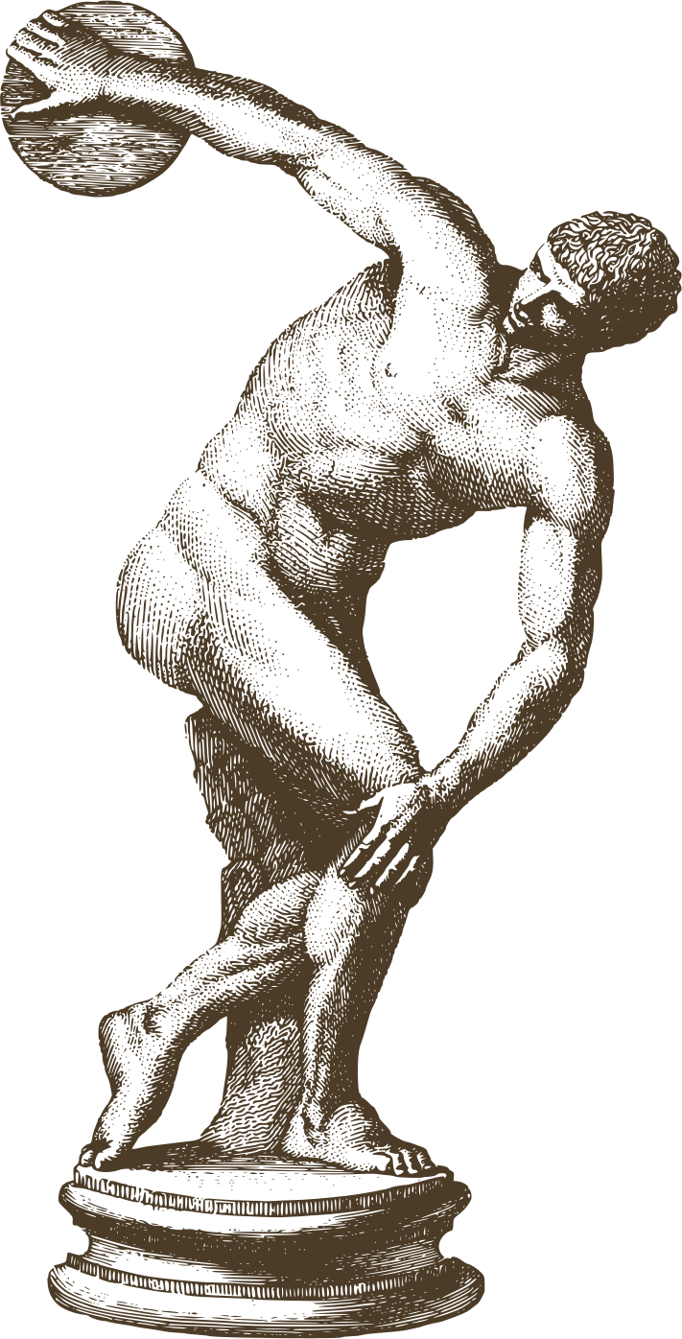
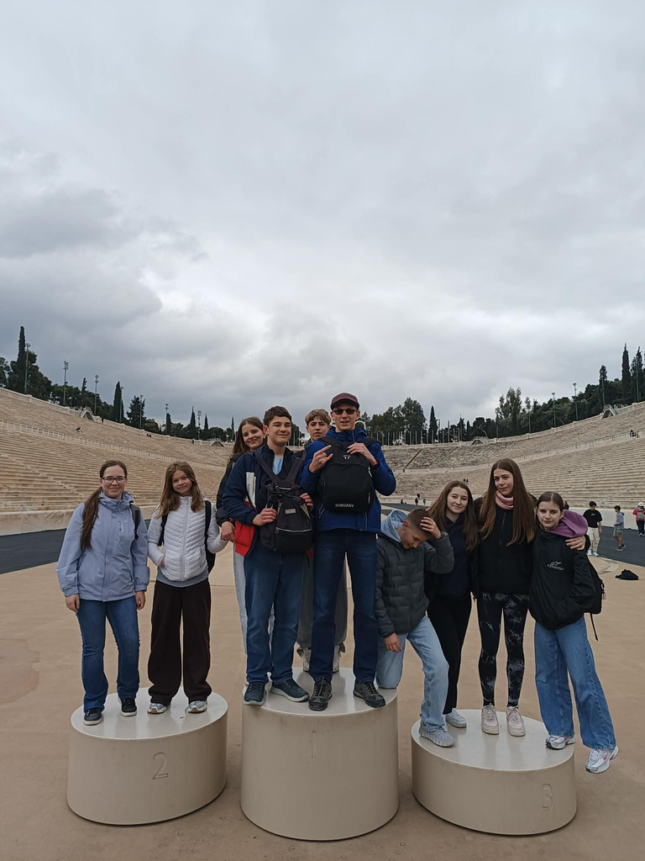
SPORT AND OLYMPICS
The birth of athletic competitions
The firts Olympics were in 776 BCE in Olympia.They honored Zeus.They were held every four years.Only men could compete.Events included running and wrestiling.Winners got olive wreaths.Wars stopped during the games.
10

Slide 11
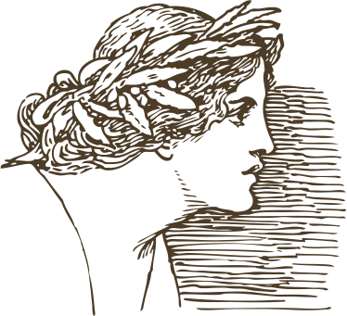
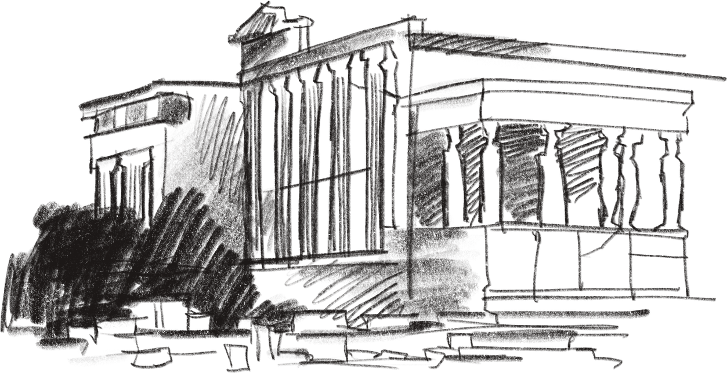
THANK YOU FOR YOUR ATTENTION!
11

