Slide 1



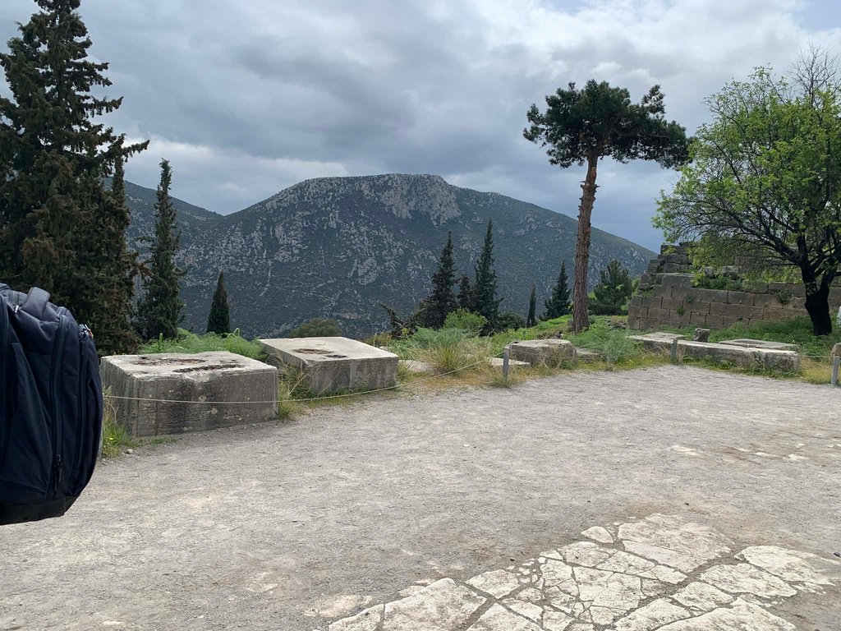
G
D
elphi,
reece
The Glory of Ancient Greece
Csongrádi Batsányi János Gimnázium
2025-1-HU01-KA121-SCH-000333716

Slide 2
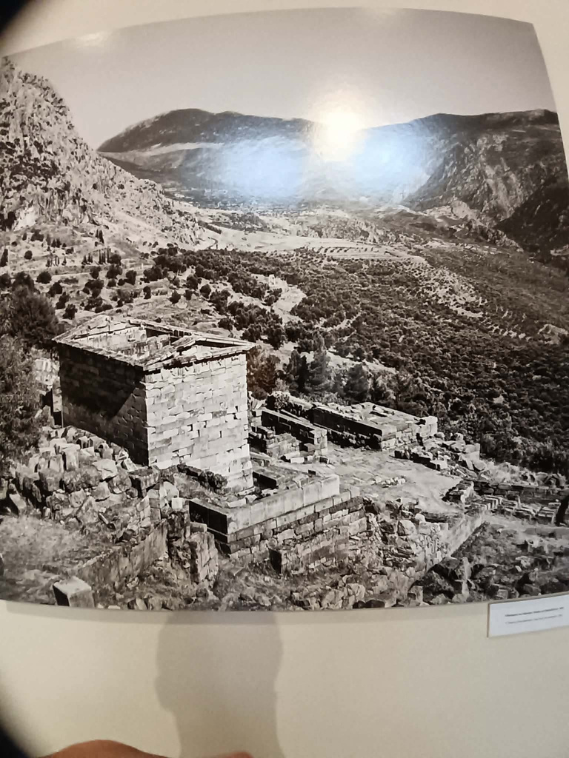

ntroduction
I
Delphi was an important ancient Greek city known for its religious significance. It was considered a sacred place where people believed they could communicate with the gods.
Delphi was not only a religious center but also a place where culture, ideas, and traditions were shared.
Especially famous for the Oracle of Apollo
The Birthplace of Western Civilization

Slide 3
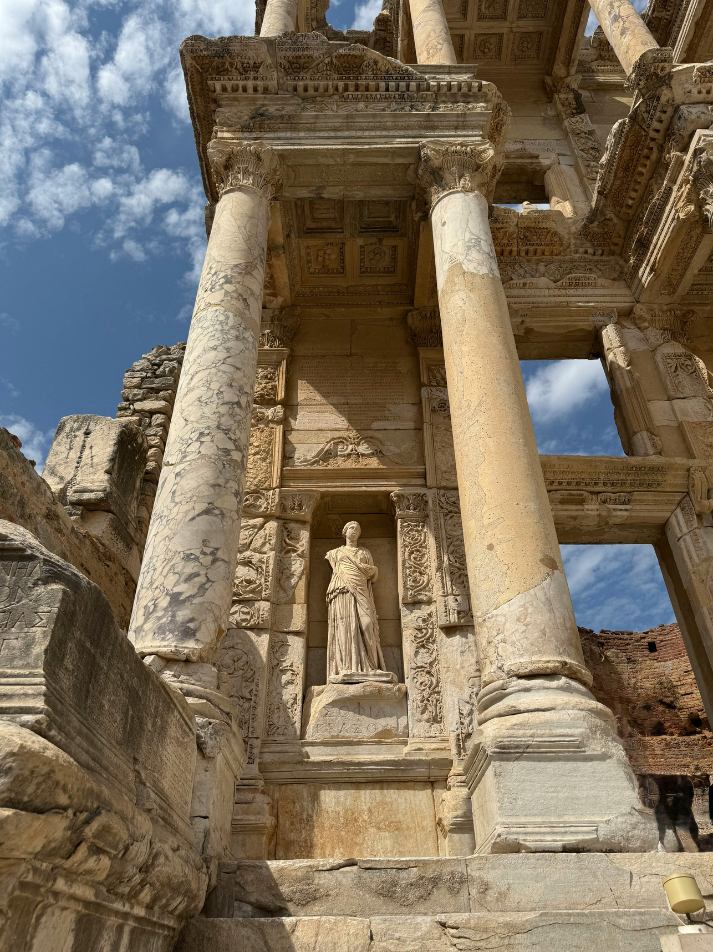
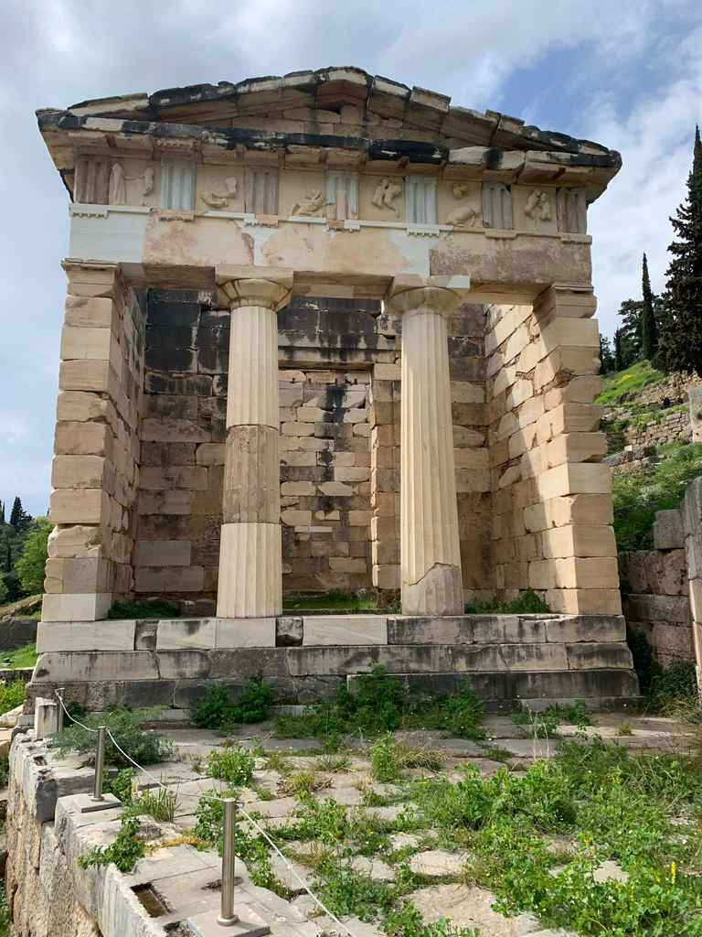

ducation and
E
Developing the Mind and Body
Children used wax tablets as early writing tools
L
earning
Delphi didn’t have formal schools like Athens
It key role in the spread knowledge and wisdom
Most important institution: Orcale of Apollo
Meeting place for: leaders, philosophers
travelers
Education was central to Greek cultural identity, focusing on intellectual and physical development.
Pythian games
Fact
Reading, writing, mathematics, and music taught from a young age
Physical training emphasized discipline, strength, and balance

Slide 4
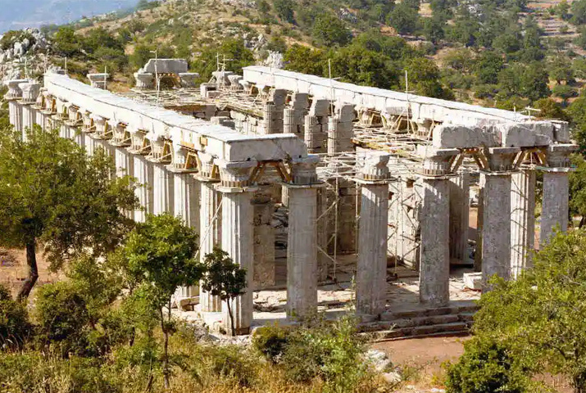
I. The cult of Apollo
Delphi was dedicated to Apollo
Apollo: the god of light, music, and prophecy
It was believed that Apollo spoke to people through the Oracle at Delphi
Temple of Apollo
R
eligion and
eliefs
B
Mythology as a Cultural Framework

Slide 5
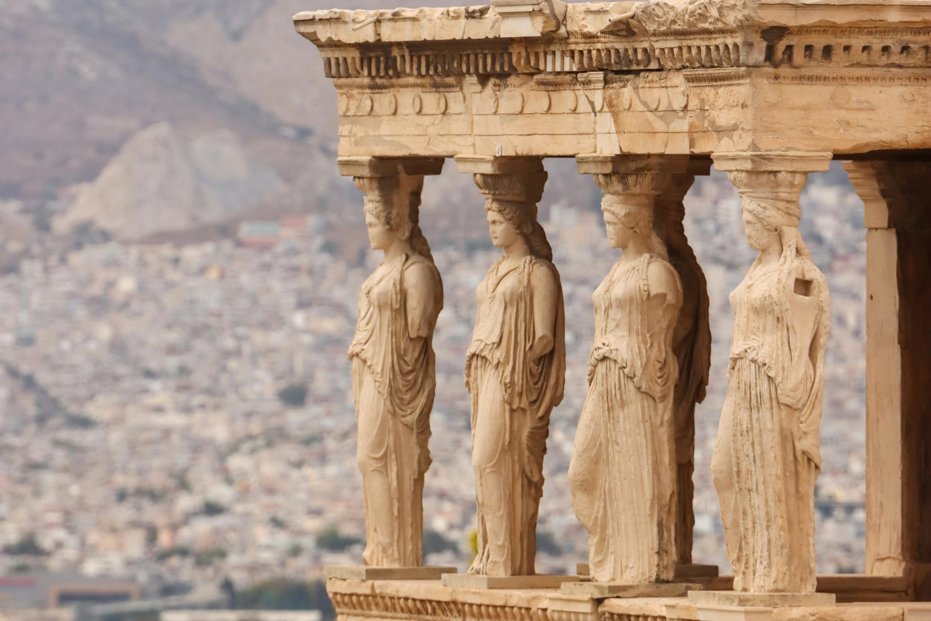
The Oracle of Delphi
Mythology as a Cultural Framework
Polytheistic beliefs guided decisions and daily behaviors
Natural forces—storms, harvests, seas—were linked to divine influence
Rituals sought protection, prosperity, and balance
R
eligion and
Temples served as religious, cultural, and administrative centers
Annual festivals brought together entire communities
Oracles and sacred sites were visited for guidance
B
eliefs
More than 1,000 local festivals were celebrated across Greek lands annually

Slide 6
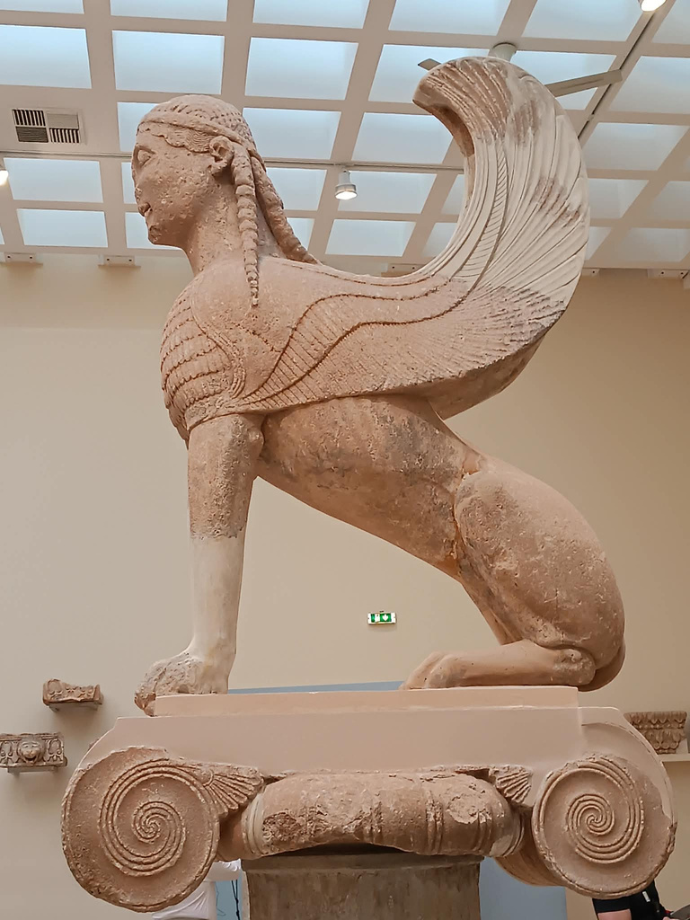
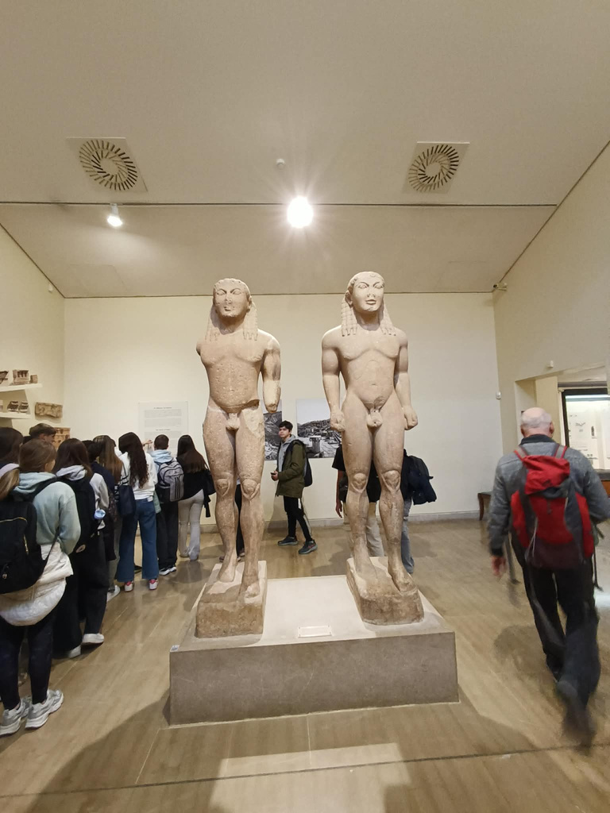

Slide 7
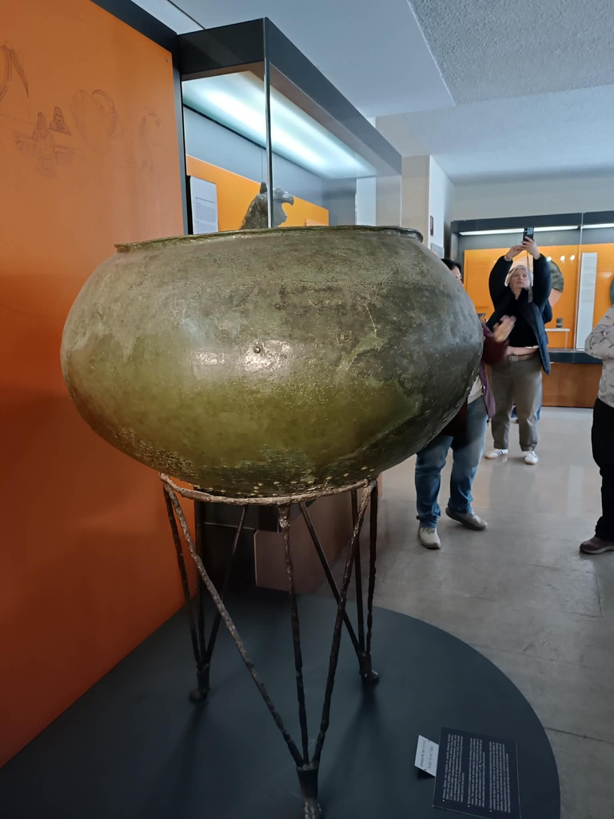
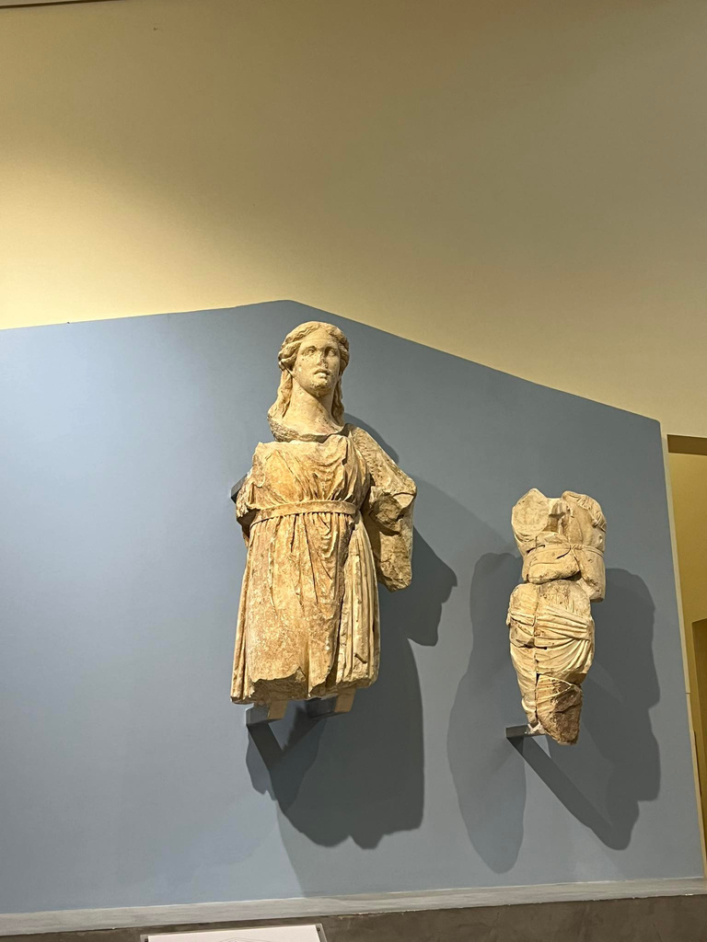

Slide 8
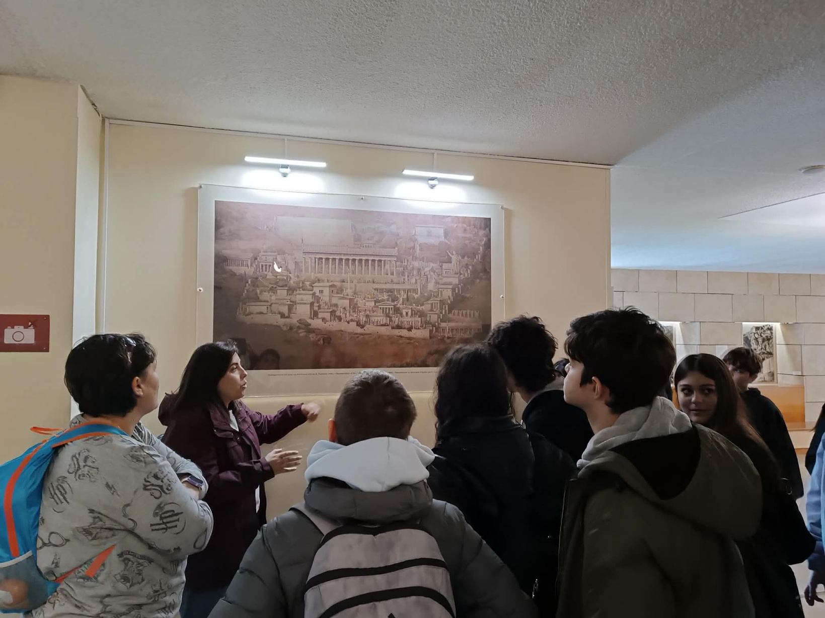

Slide 9
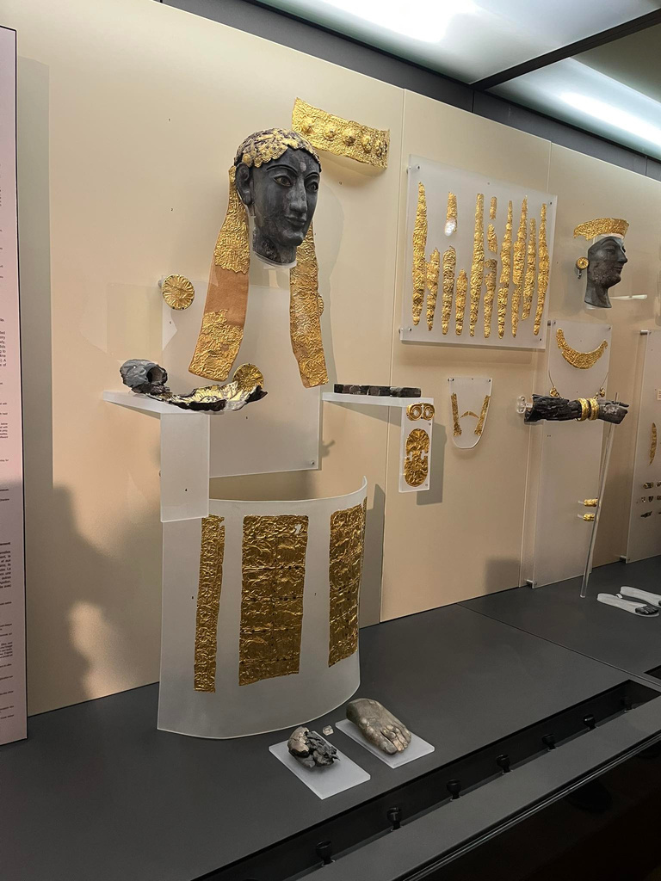
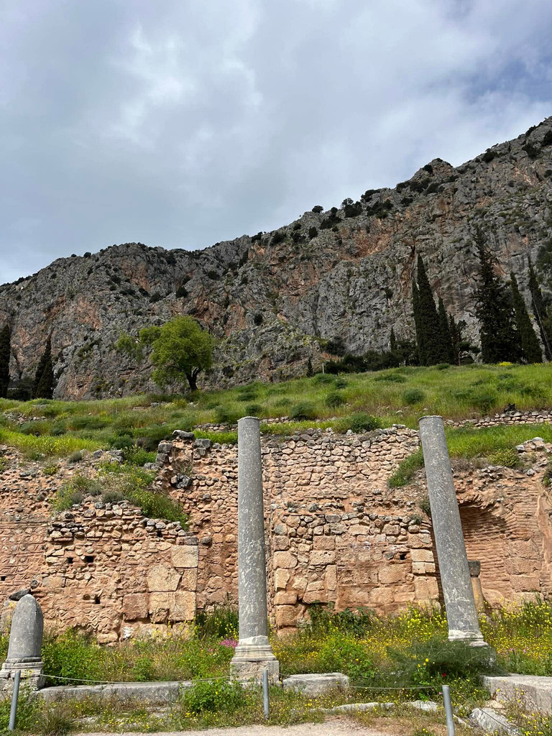

Slide 10
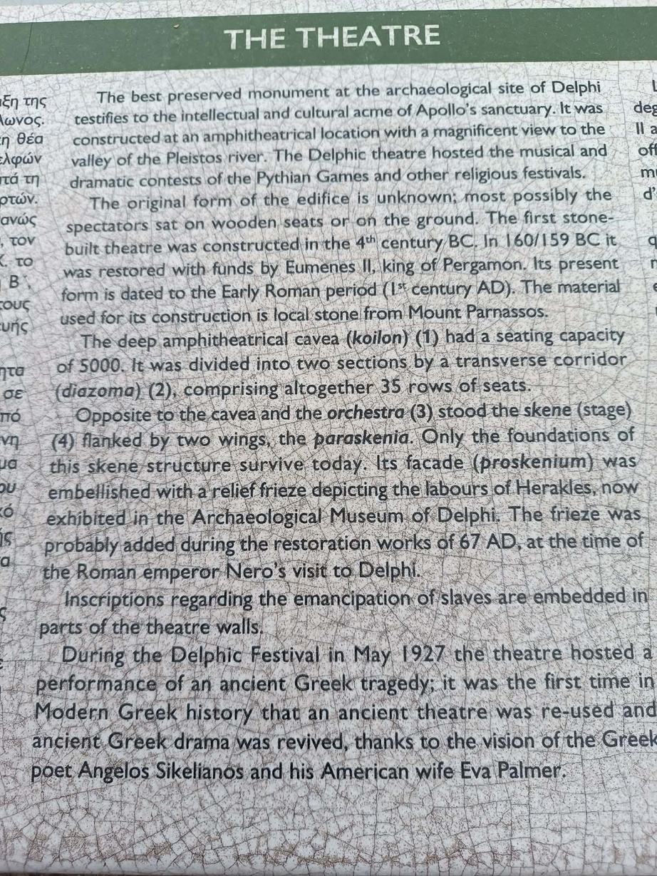
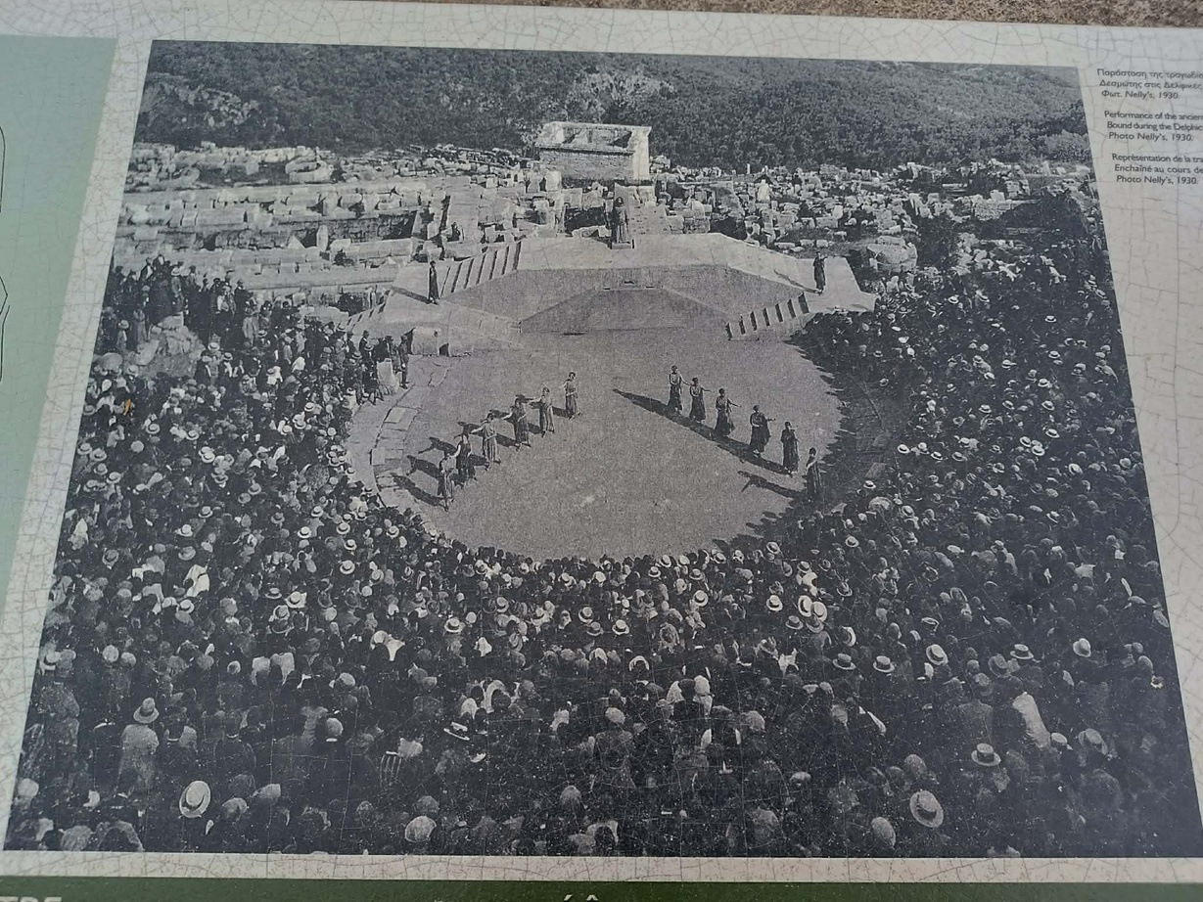

Slide 11
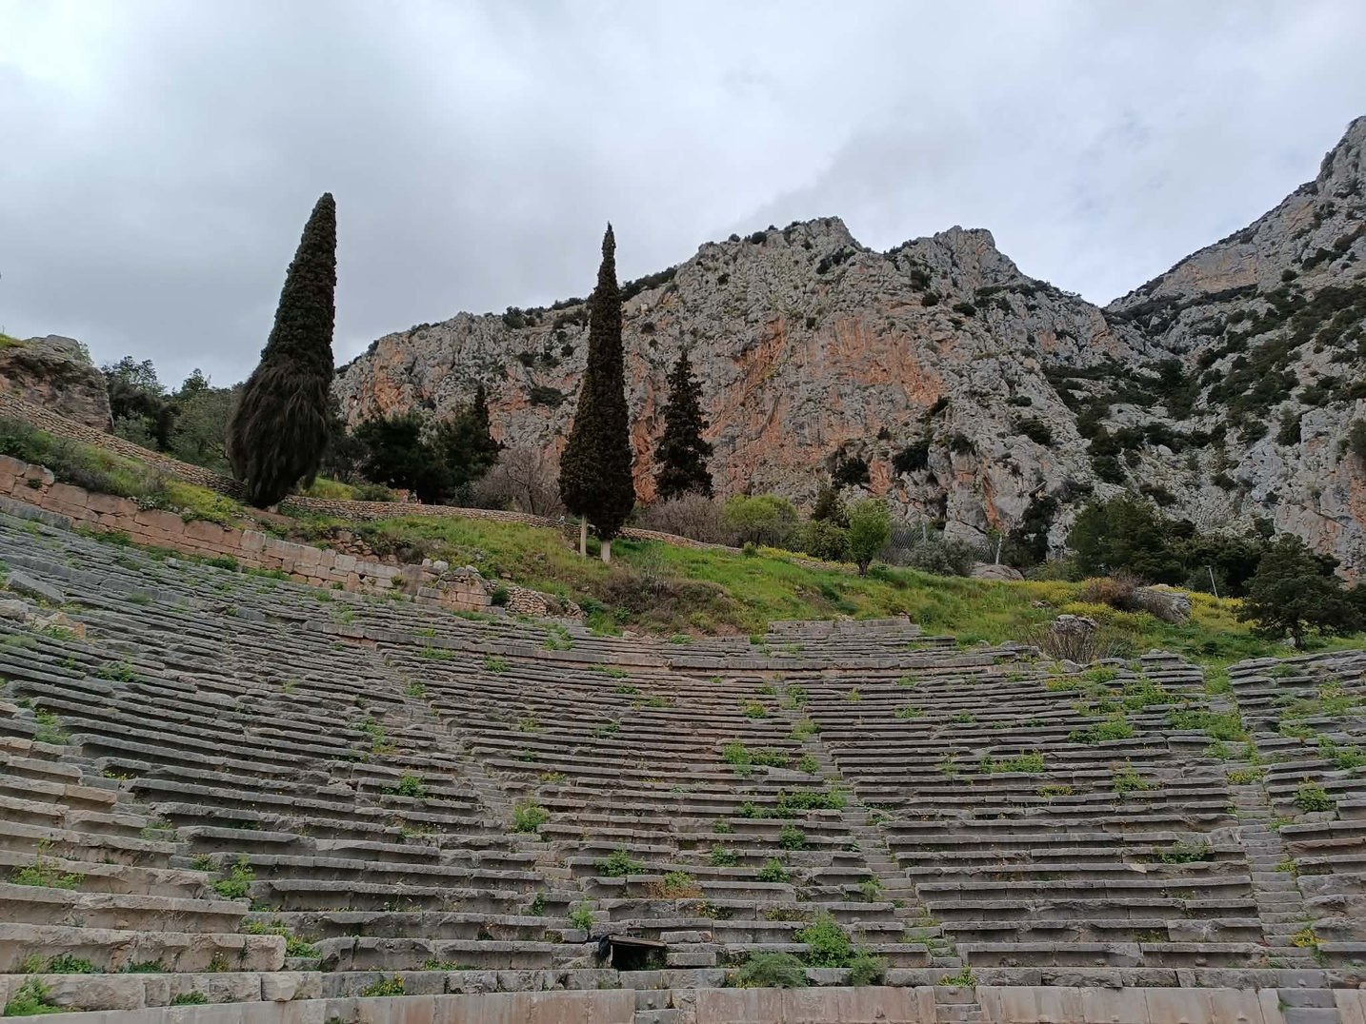

Slide 12
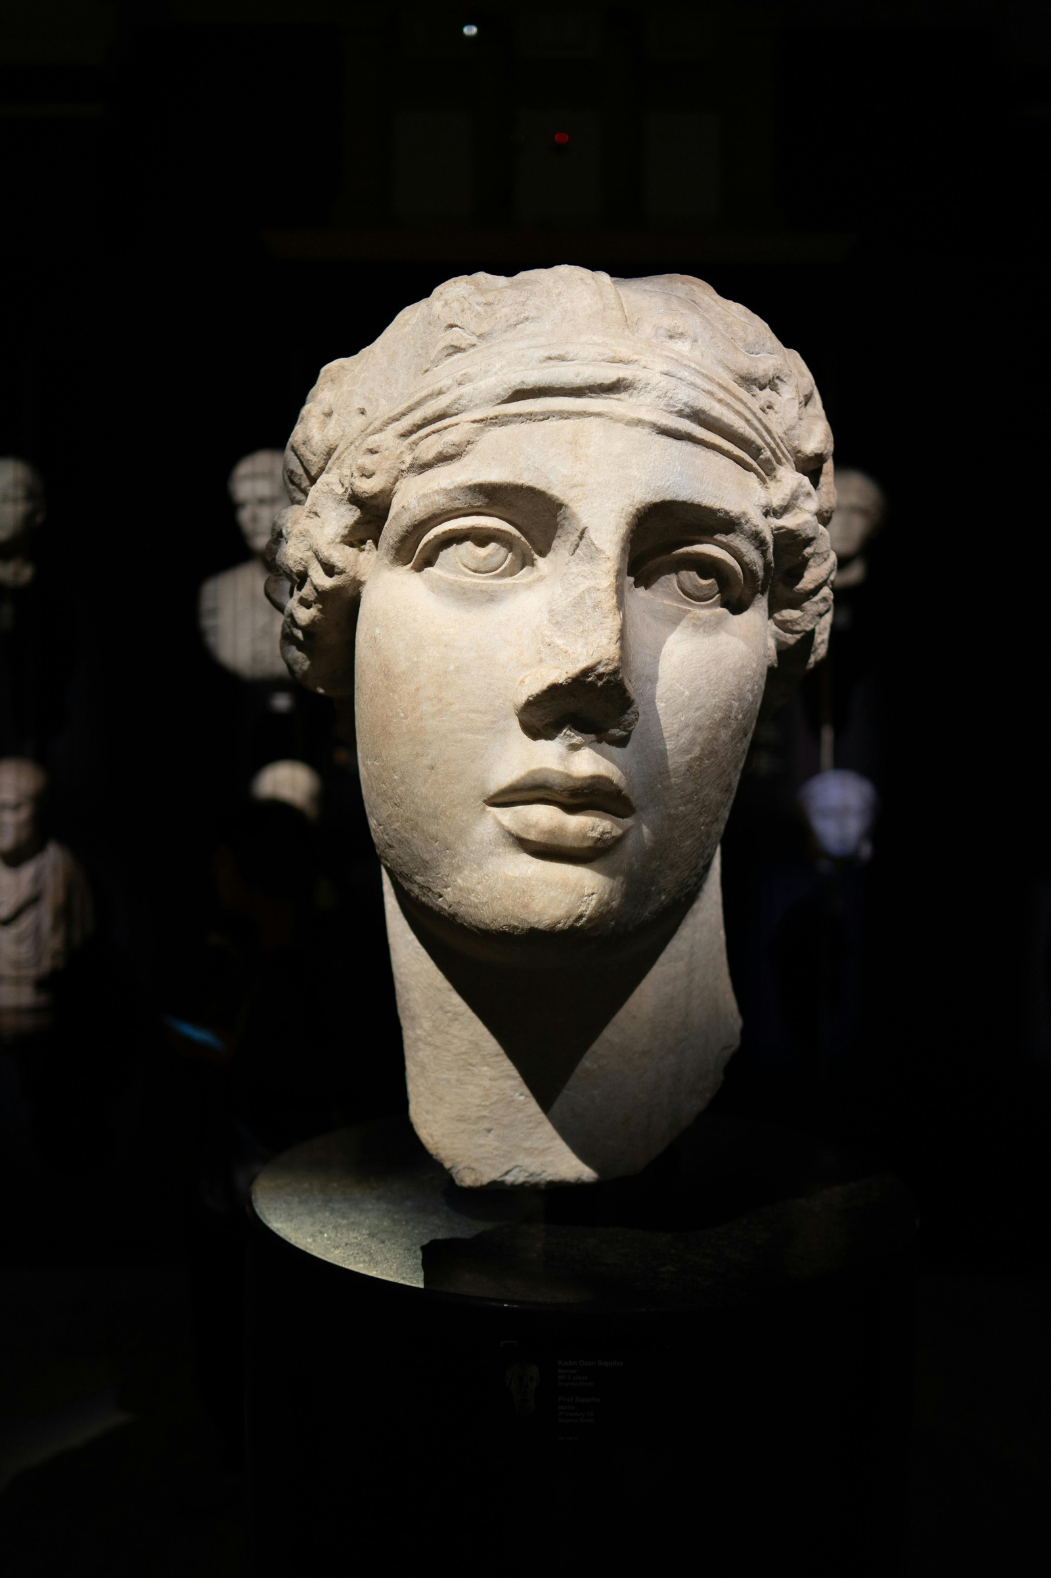
C
losing
A Civilization That Continues to Shape the Modern World
Legacy of Ancient Greece
Fact
Ancient Greece continues to inspire global society through its values, innovations, and pursuit of knowledge leaving a legacy that transcends time.
Borcelle

