Slide 1
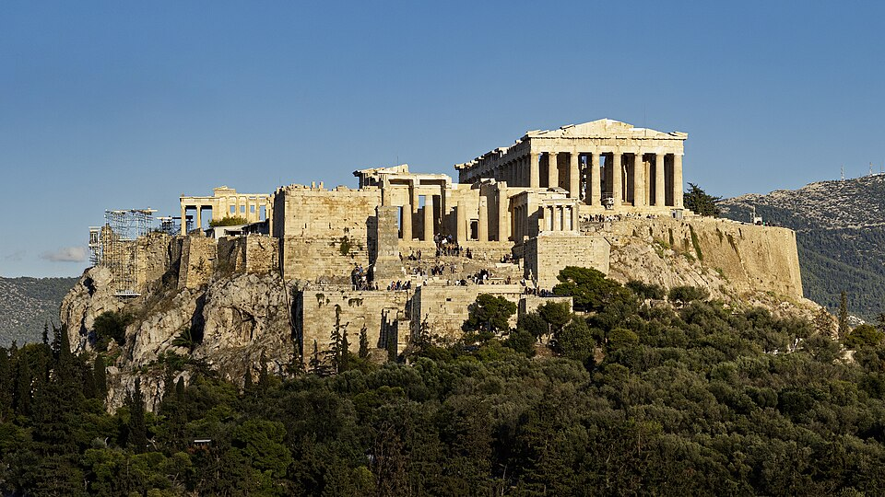
ACROPOLIS
GREECE
Made by: Bárdos Hanna
Barta Zsanett

Slide 2
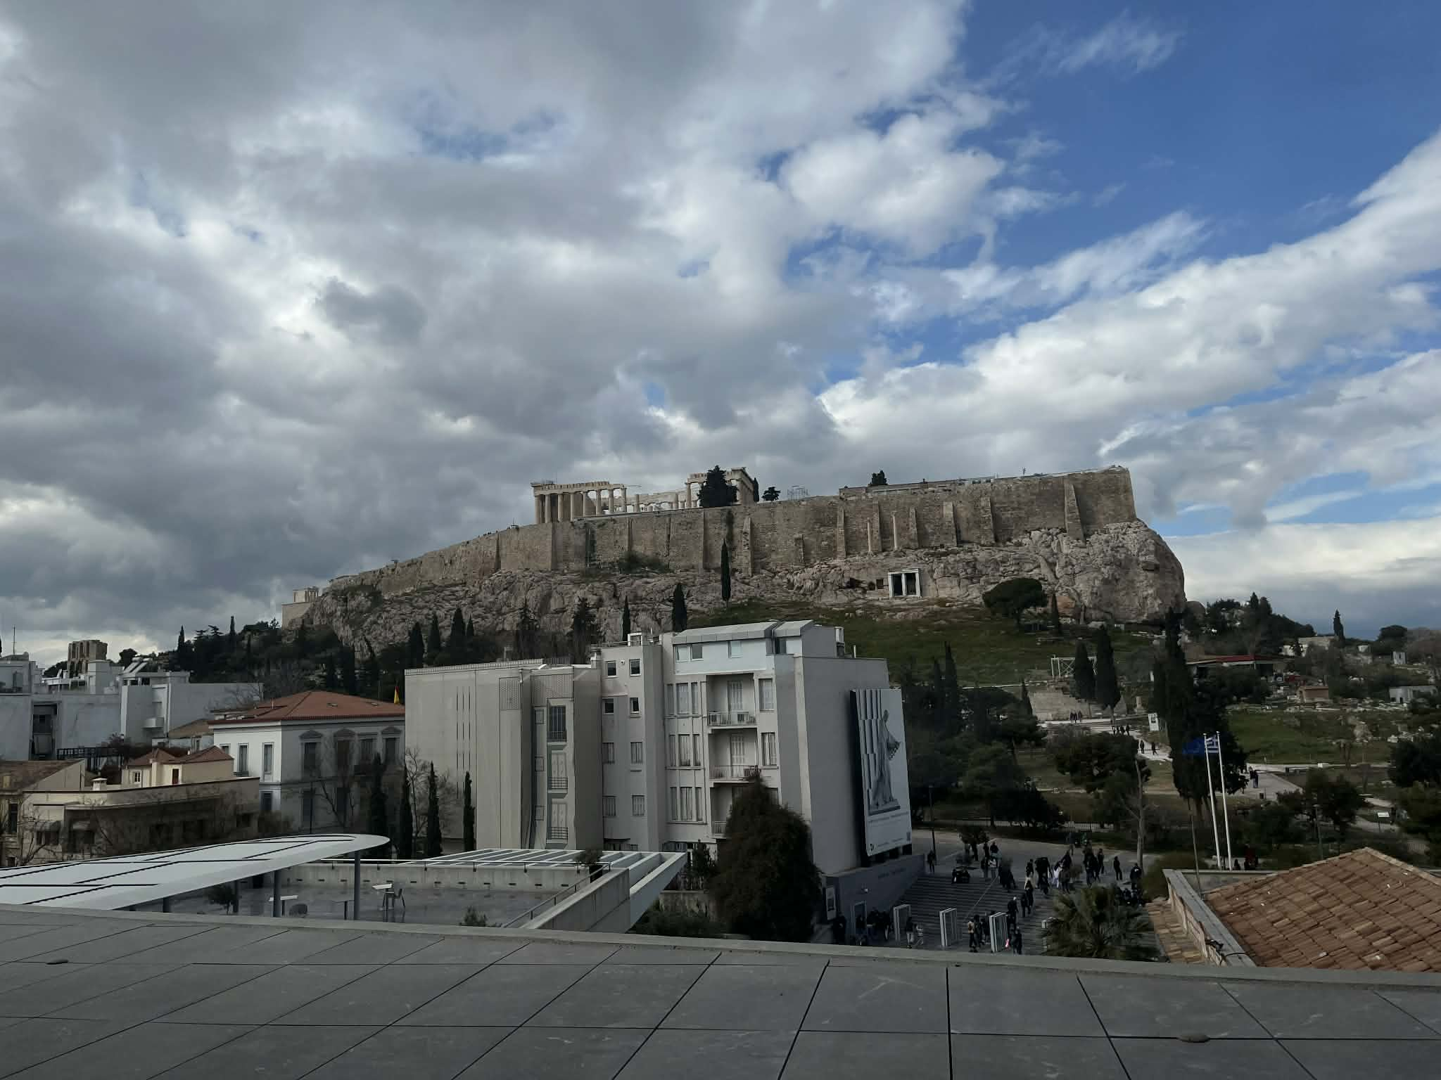
What is the Acropolis?
The Acropolis is a rocky hill located in the center of Athens, rising above the city. It was chosen for its natural defense and visibility. In ancient times, it functioned as a fortified complex that contained temples and important public buildings. Today, it remains a symbol of ancient Greek civilization and heritage.

Slide 3
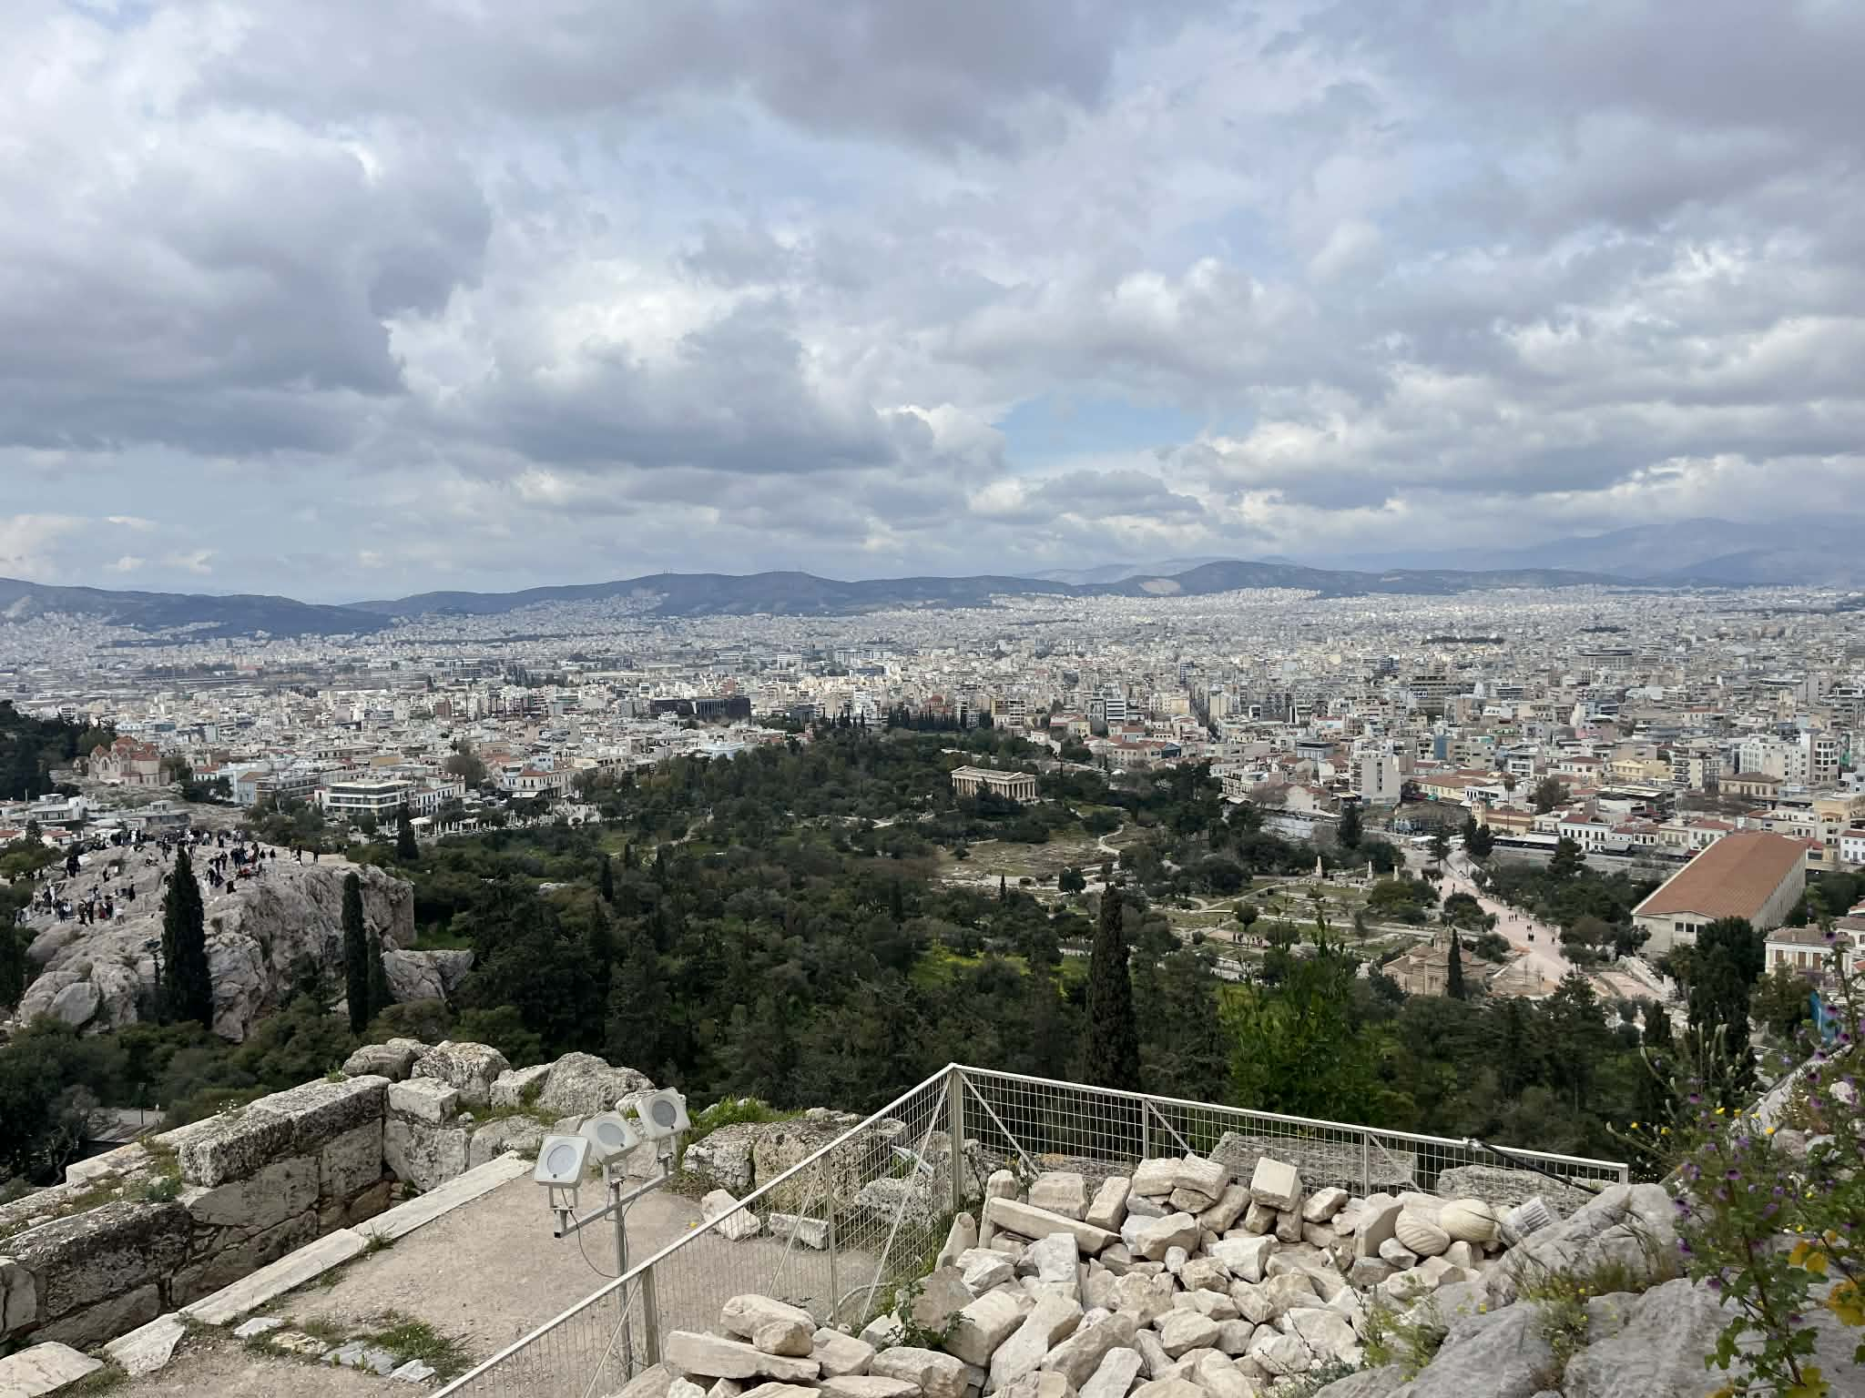
Meaning of the Name
The word “Acropolis” comes from Greek: “akron” meaning high and “polis” meaning city. It describes a fortified area built on elevated ground.

Slide 4
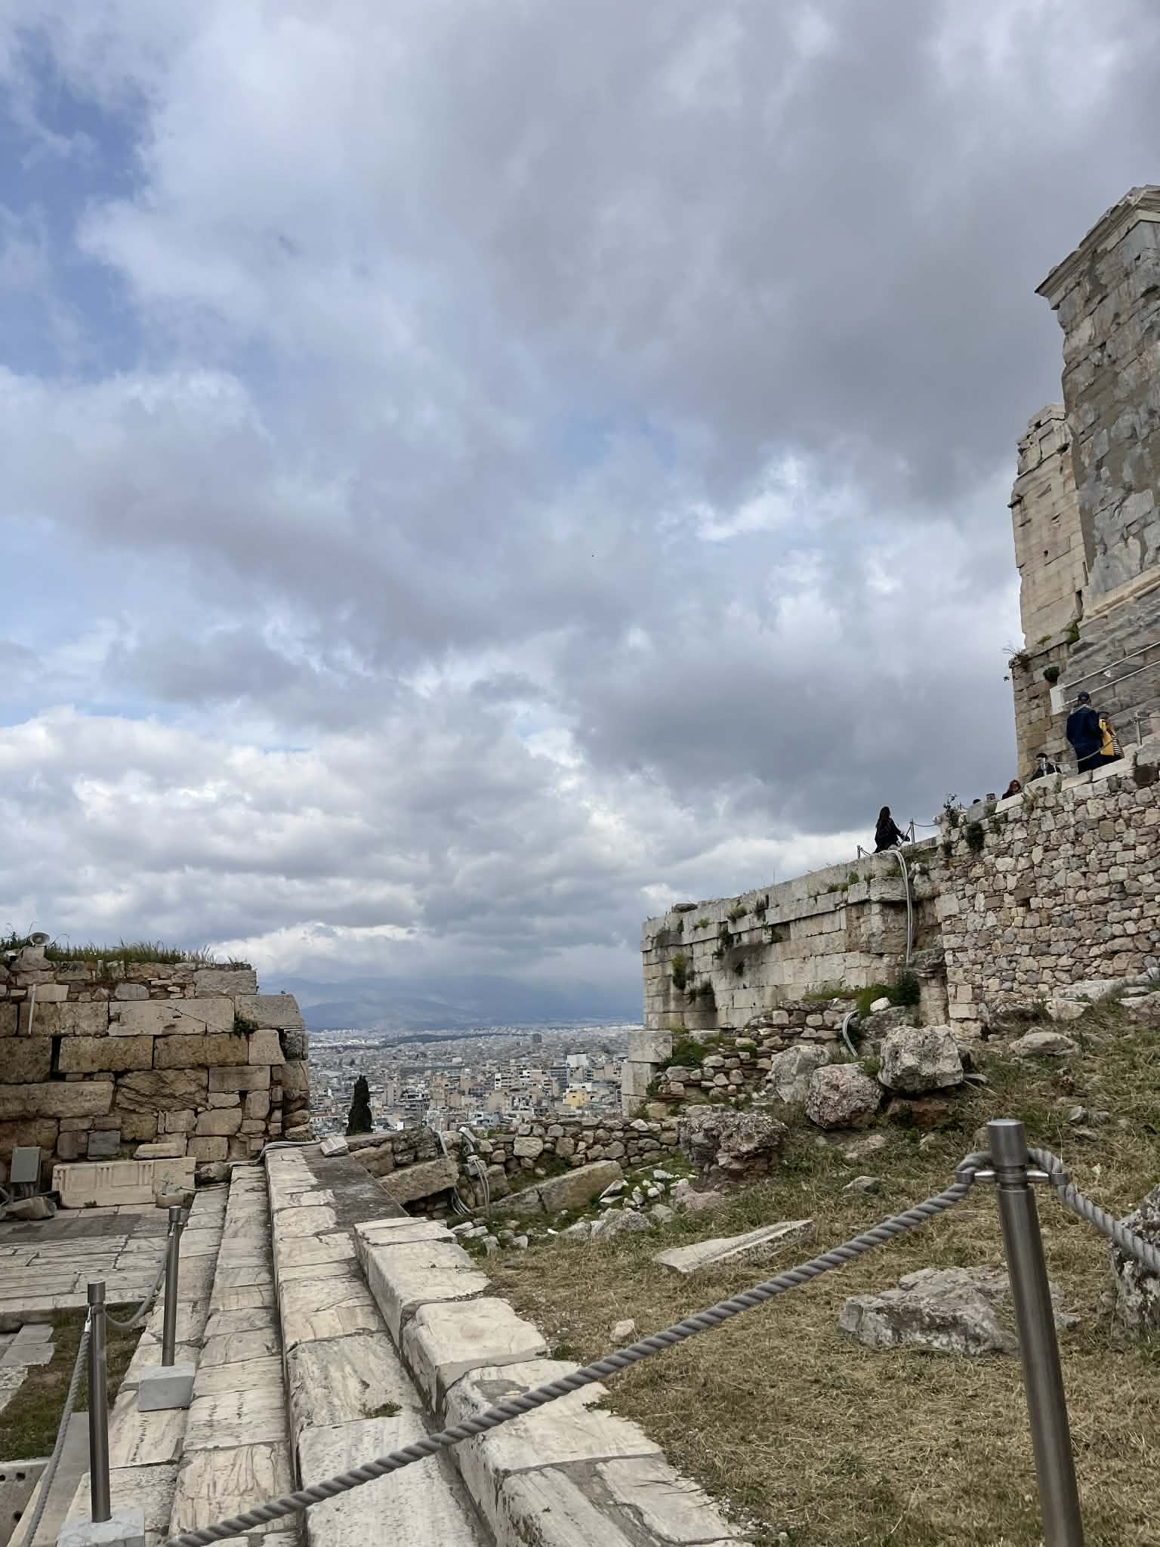
Historical Importance
In ancient Athens, the Acropolis was the center of political power, religion, and public life. Important ceremonies, celebrations, and decisions took place here.

Slide 5
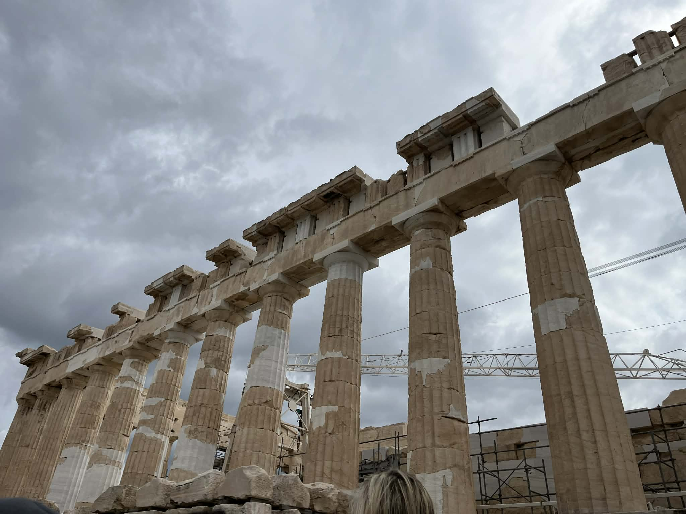
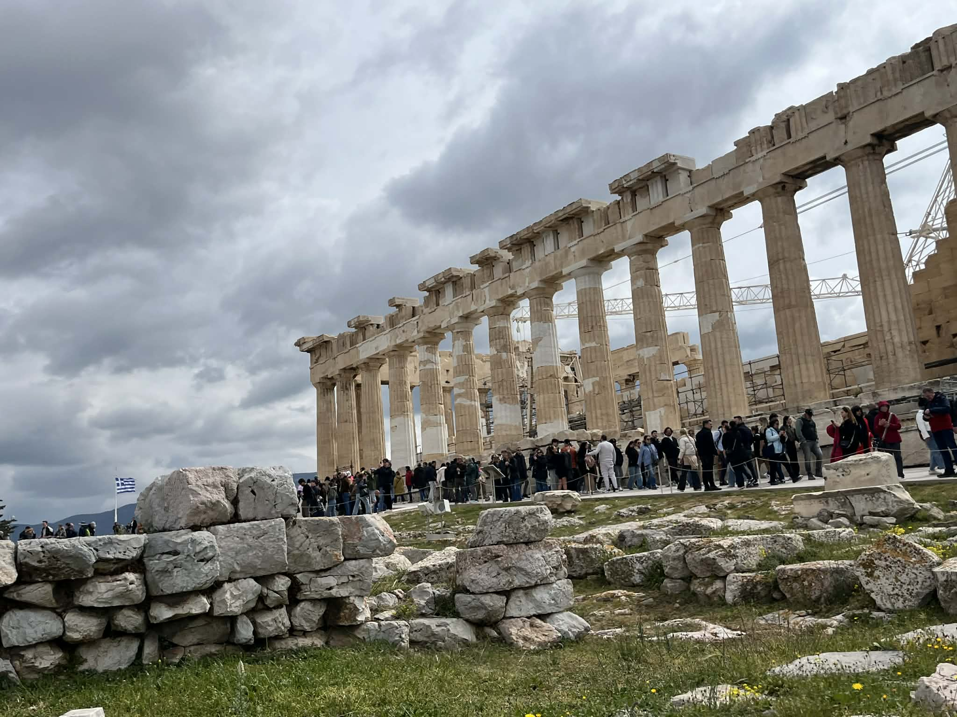
The Parthenon
The Parthenon was built in the 5th century BC during the Golden Age of Athens.
It was dedicated to Athena and also served as a treasury for the city.
Its design reflects advanced mathematical precision, with slight optical adjustments that make it appear perfectly.

Slide 6
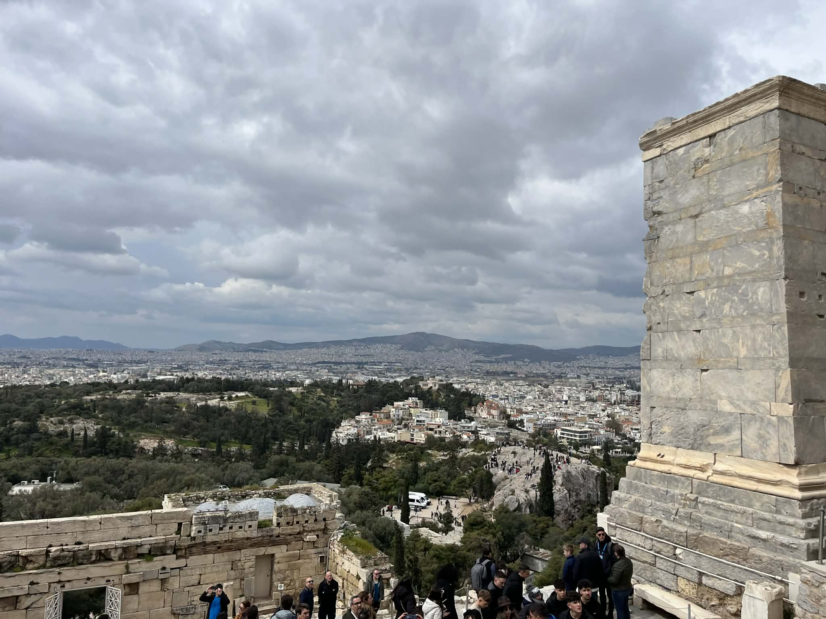
Athena and the Myth
According to Greek mythology, Athena and Poseidon competed to become the patron deity of Athens. Poseidon offered a saltwater spring, while Athena offered an olive tree. The olive tree was considered more valuable because it symbolized peace, food, and trade.

Slide 7
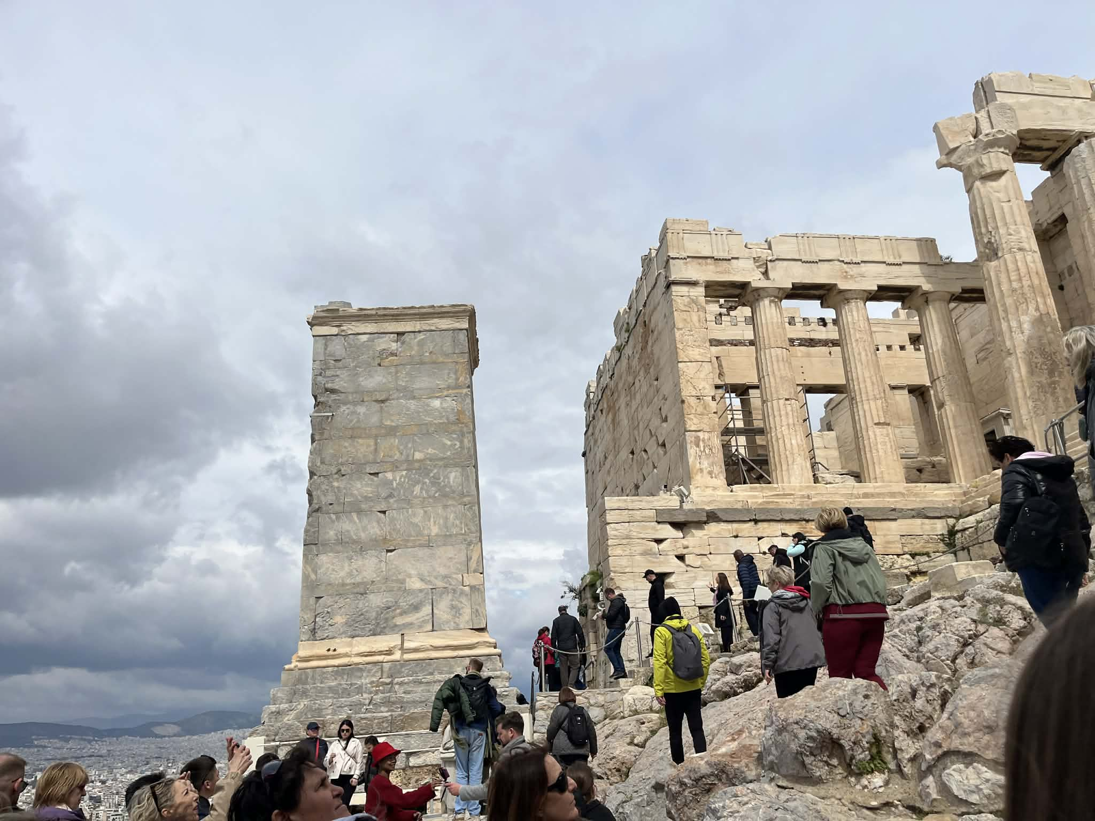
The Propylaea
The Propylaea was the grand entrance to the Acropolis. Visitors passed through this impressive gateway, which showed the importance of the sacred site.

Slide 8
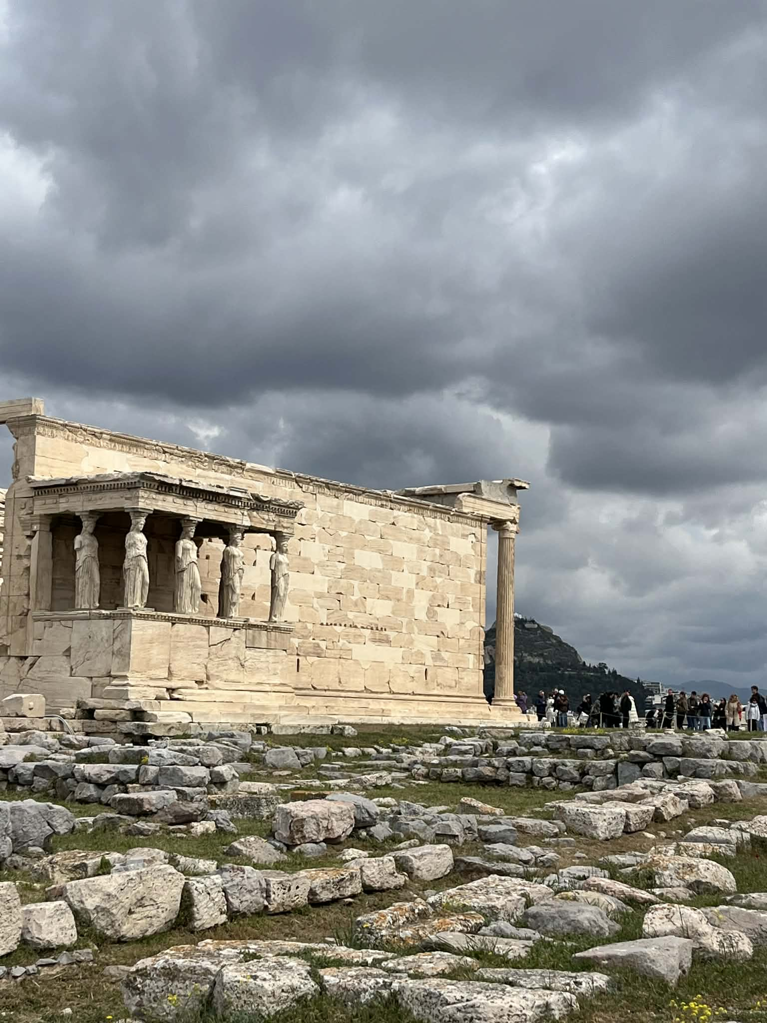
The Erechtheion
The Erechtheion is known for its unique design and the Caryatids, female statues used as columns. It was dedicated to multiple gods and myths.

Slide 9
Poseidon and the Myth
According to Greek mythology, Poseidon was one of the main gods of the sea. He competed with Athena to become the protector of Athens.
Although Poseidon did not win the city, he is still honored in the myths connected to the Acropolis, especially in the Erechtheion.
Poseidon struck the rock of the Acropolis with his trident and created a saltwater spring as his gift. However, the citizens preferred Athena’s olive tree, which symbolized peace and prosperity.

Slide 10
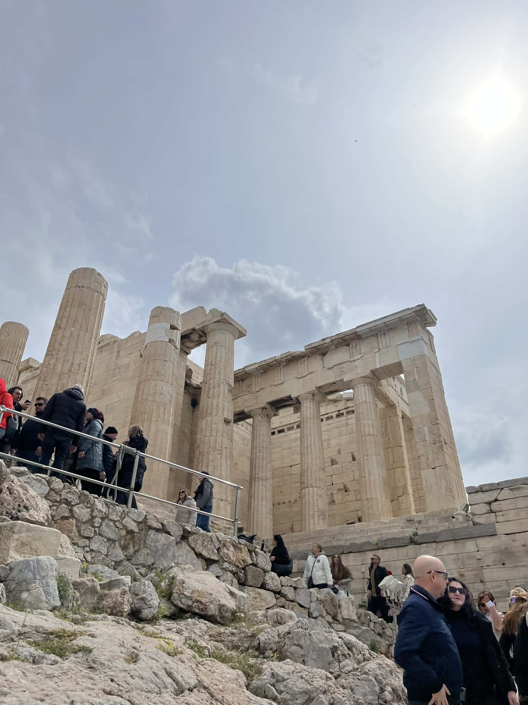
Temple of Athena Nike
This small temple was built to celebrate victory in battles. It represents Athena as the goddess of victory and success.

Slide 11
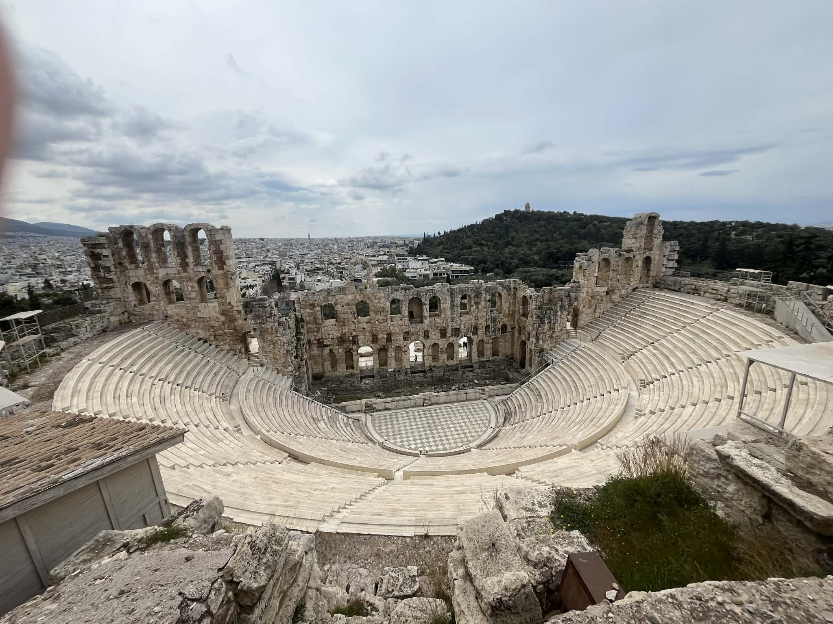
Theatre of Dionysus
The Theatre of Dionysus could hold thousands of spectators and is considered the birthplace of Greek drama. Famous playwrights like Sophocles and Euripides presented their tragedies here during religious festivals dedicated to Dionysus, the god of wine and theatre.

Slide 12
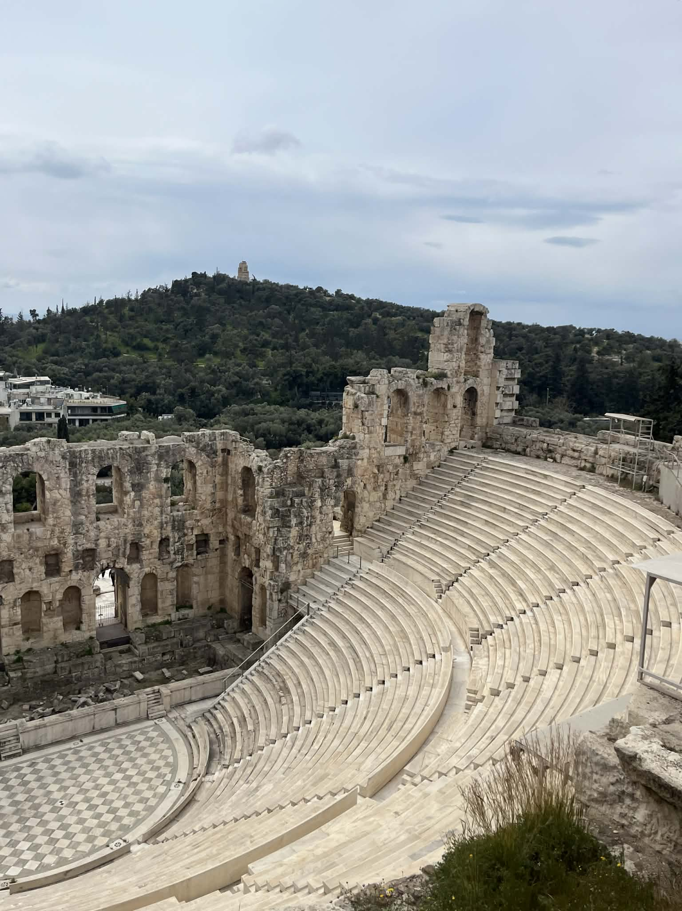
Odeon of Herodes Atticus
Built during Roman times, this theatre is still used today. It hosts concerts, performances, and cultural events.

Slide 13
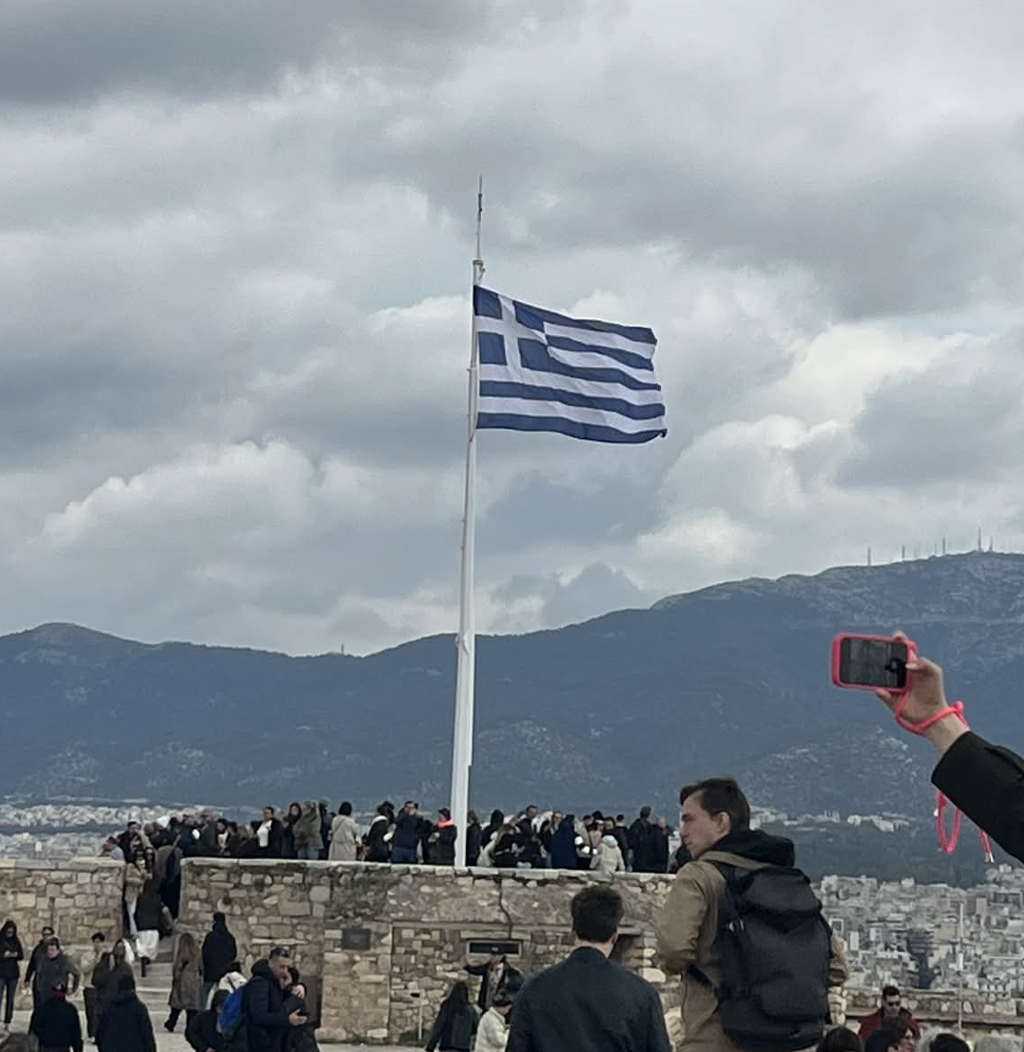
Daily Life and Rituals
The Acropolis was not just for buildings. People gathered here for festivals, sacrifices, and religious ceremonies honoring the gods.

Slide 14
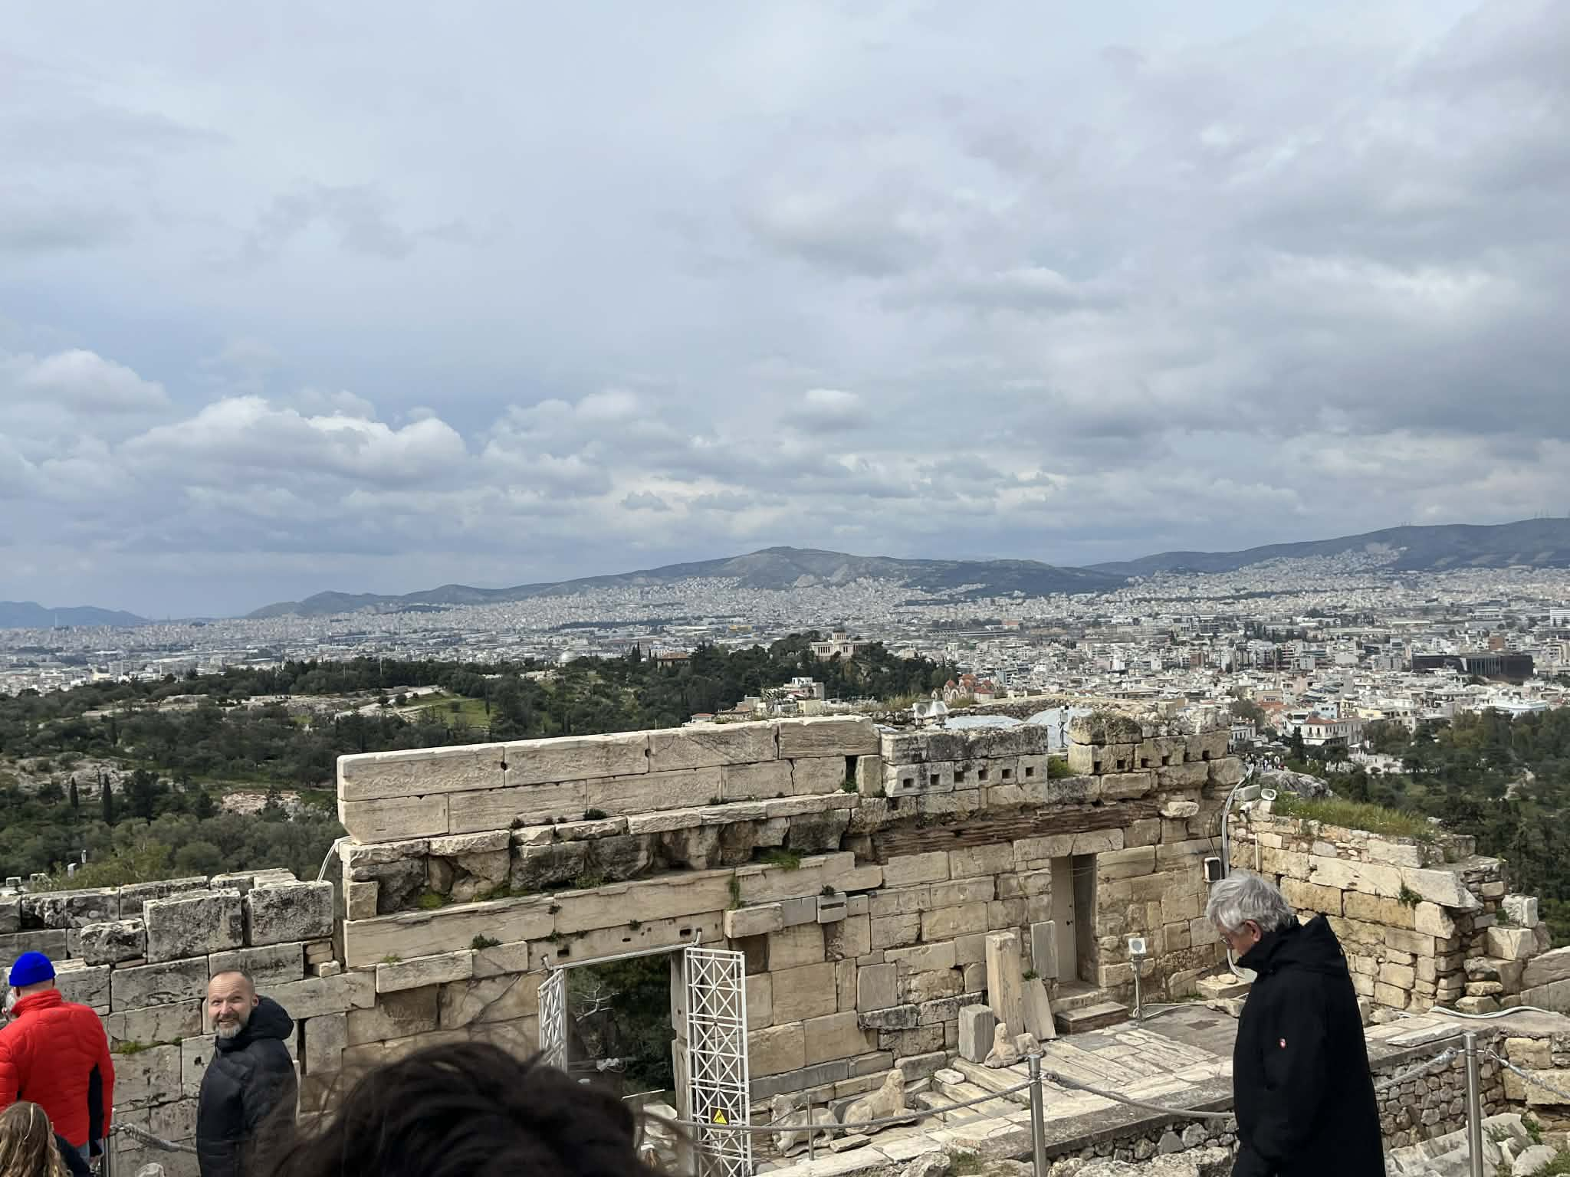
Damage and History
Over centuries, the Acropolis suffered damage from wars, explosions, and natural forces. Some buildings were destroyed or heavily damaged.

Slide 15
Restoration Today
Restoration of the Acropolis is a complex and ongoing process. Experts carefully use original materials where possible and modern techniques to stabilize the structures.
The goal is not to rebuild completely, but to preserve authenticity and protect the monuments from further damage.

Slide 16
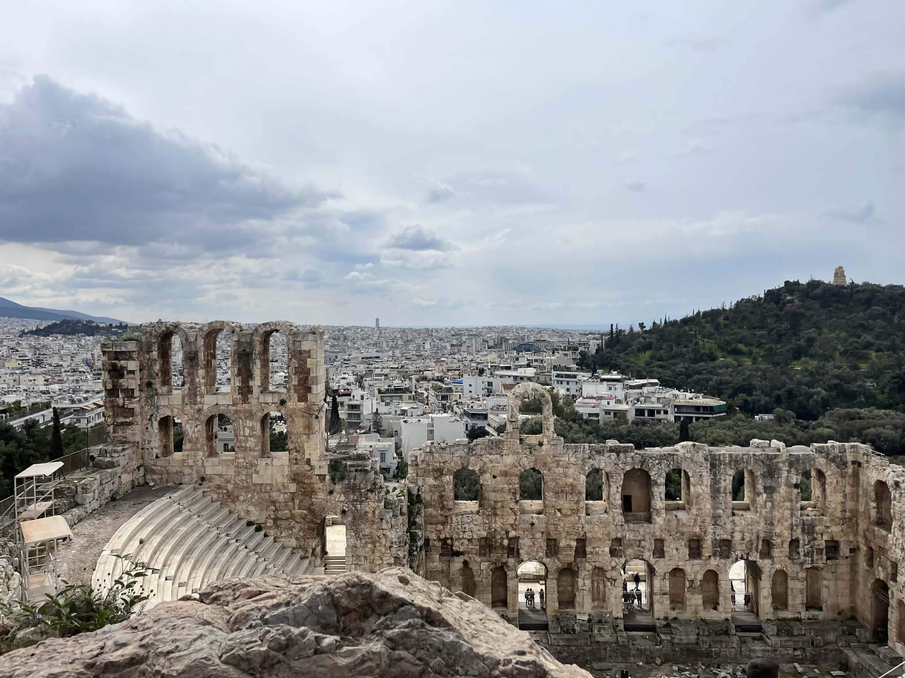
Why Visit the Acropolis?
Visiting the Acropolis is like stepping back in time. It offers amazing views, rich history, and a deep connection to ancient Greek culture.

Slide 17
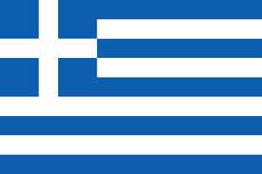
Thank you for your attention!

